Slide 1
International perspectives on reablement - an active ageing
approach in home care
European Educational Symposium,
Sept 26th , 2024
Tine Rostgaard, Professor,
Roskilde University, Denmark

Slide 2
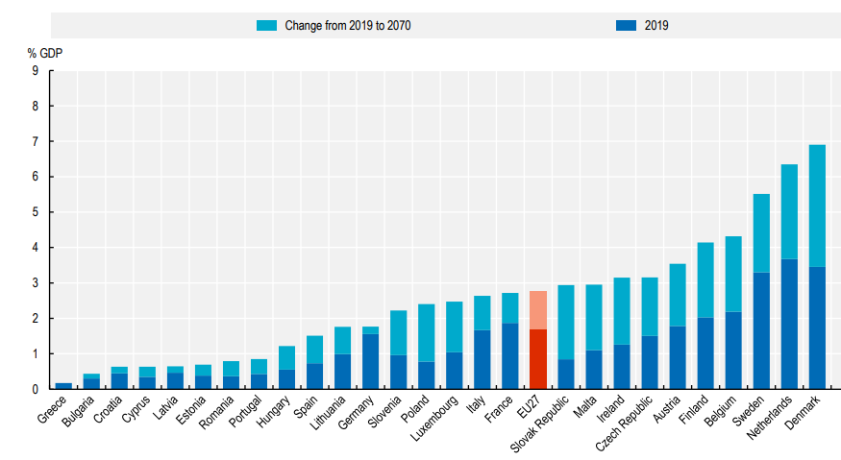
Drivers for innovative approaches to LTC
Ageing societies with increase in no. of OPs with long-term conditions and need for health and social care
Projections of increasing age-related spending
Ageing-in-place: Many wish to remain in their own homes as they age
Demographic and cultural change: Changes in household composition and preference for formal care. Preferences for person-centered care
Projected change in LTC expenditure by 2070, % GDP, OECD countries
Source: OECD (2022) Health at atglance

Slide 3
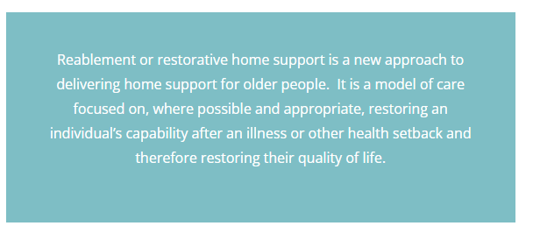
What is reablement?
What is reablement ?
Notes:
https://reable.auckland.ac.nz/
3:37

Slide 4
Reablement: Main components
An alternative to conventional home care, enabling and developmental perspective
Training in every day activities in a familiar setting, adapting existing routines, physical training, assistive devices, and adaption of home
Aim of maintaining or even gaining function
Short-term and intensive intervention (4-10 weeks) at home.
Inter-disciplinary and team-based approach, involving social care workers, occupational and/or physiotherapists, nurses, dieticians etc.
Person-centered and co-produced with user,‘what is important to you?’
Goal-oriented for motivation
Source: Metzelthin, Rostgaard, Parsons, Burton (2022) Development of an internationally accepted definition of reablement: a Delphi study. Ageing and Society

Slide 5
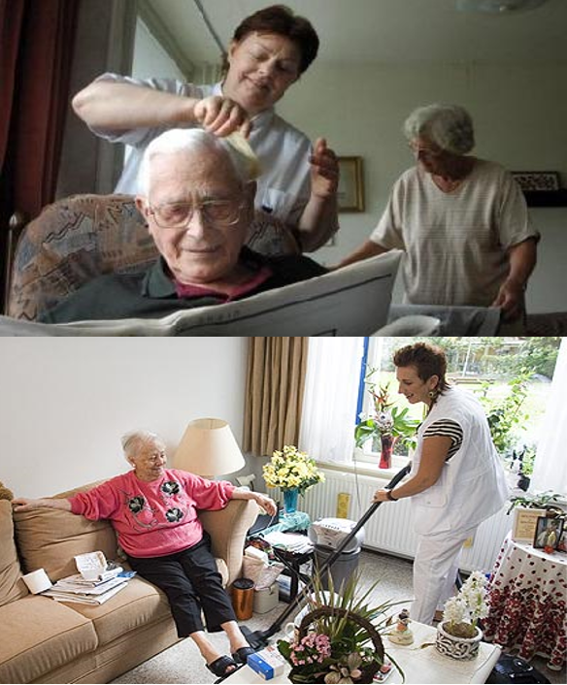
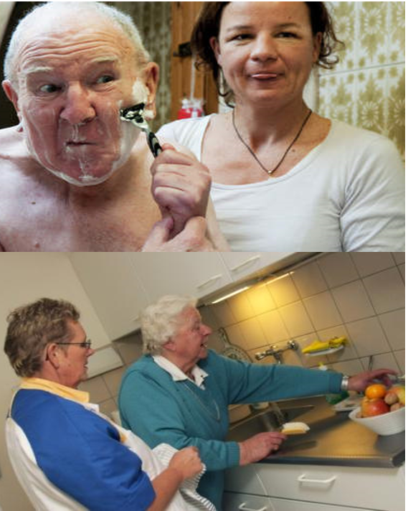
From ‘passive’ to ‘active’ care: ‘Doing for/to’ ‘Doing with’

Slide 6
From mono- to inter-disciplinary interventions and collaboration
‘Doing together’ instead of ‘Doing along’

Slide 7
Potentials of reablement
Reablement is a risk-minimisation strategy that helps older individuals adapt to age-related changes and prevent certain dependencies.
A policy tool that offers national and local governments capacity for dynamically managing and addressing the societal risks associated with population ageing
What is reablement ?
Notes:
https://reable.auckland.ac.nz/
3:37

Slide 8
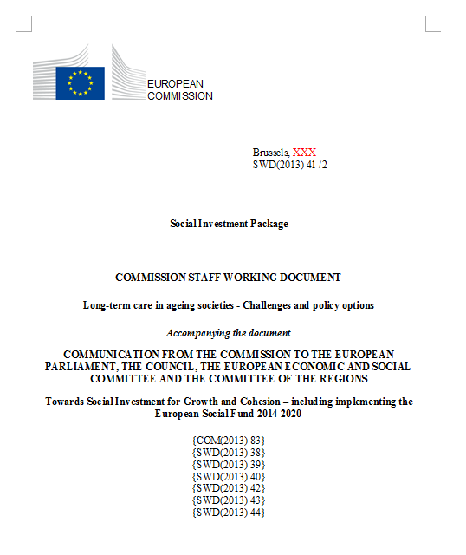
In accordance with current ageing paradigms and policy trends
Active ageing discourse
Part of EU Commission Social investment package 2013
UNECE’s 2012 Vienna Ministerial Declaration
- Requires UNECE member states to be ”commited to raising awareness about and enhancing the potential of older people for the benefit of our societies and to increasing their quality of life by enabling their personal fulfilment in later years, as well as their participation in social and economic development.”
Feb 2013: László Andor,
EU Commissioner for Employment, Social Affairs and Social Inclusion

Slide 9
Does it improve client-level outcomes?
Few studies with rigorous research methodologies high on evidence hierarchy
So still weak collective evidence, that reablement enables older adults to have better personal outcomes than if they had received conventional home cares.
In half of the studies, reablement improved ADL functioning (Buma et al, 2022)
Change components: Strong indications that the use of more diverse interdisciplinary teams, a standardised assessment and goal-setting method can improve daily functioning (Buma et al, 2024)
And client outcomes are not worse than for non-participants, most clients satisfied with the service and what they feel they have achieved. Promising in regard to self-efficacy in daily activities and quality of life (Levin et al, 2022)
So ‘just the right thing to do’?
Sources: Buma et al (2024) Exploring Goal-Setting and Achievement Within Reablement: A Comparative Case Study of Three Countries; Buma et al (2022) Effects on clients' daily functioning and common features of reablement interventions: a systematic literature review; Levin et al (2022) in Rostgaard, Parsons and Tuntland, Reablement in long-term care for older people, Policy Press.

Slide 10
Is it cost-effective?
Based on an investigation of the studies looking into costs and service use.
The evidence base is still limited; additional studies designed to capture health-economic perspectives over the long term are urgently needed.
The present health economic studies of reablement are limited to studies conducted in the UK and Scandinavia
Reablement is evaluated in relation to usual care, that is conventional home care
In all studies except one, reablement resulted in positive effects on outcomes covering quality of life and performance of daily activities and/or lower costs
Indication that reablement is promising regarding cost-effectiveness compared to usual home care services,
Source: Zingmark et ell (2022) in Rostgaard, Parsons and Tuntland, Reablement in long-term care for older people, Policy Press.

Slide 11
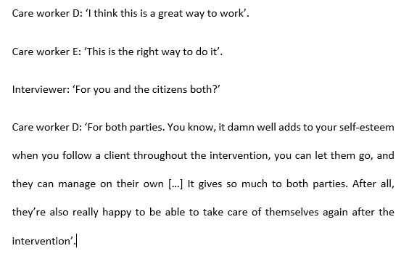
Does it motivate staff?
Source: Rostgaard and Graff, 2023, in Rostgaard et al, Reablement in long-term care for older people, Policy Press. l

Slide 12
Survey among Danish home care staff:
Developmental orientation, and cross-disciplinary and team-based approach leading to higher levels of staff satisfaction and reduced desire to quit job
No, I have no intentions quitting my job!
38% of those providing reablement, vs. 62% among those providing conventional home care
Yes, I provide person-centred care!
41% of those providing reablement vs. 19% among those providing conventional home care
Yes, my job is interesting and meaningfull!
87% of staff providing reablement vs. 57% of those providing conventional home care
Source: Rostgaard and Graff, 2023

Slide 13
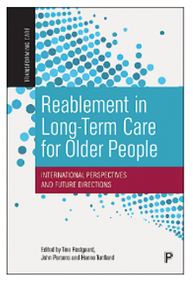
Transforming Care Book Series
Reablement in Long-Term Care for Older People
Edited by Tine Rostgaard, John Parsons and Hanne Tuntland
“Robust cross-country and interdisciplinary research shows how reablement can reduce long-term care costs, improve wellbeing and professionalise care work.”
Prof. Caroline Glendinning, University of York
policy.bristoluniversitypress.co.uk/transforming-care

Slide 14
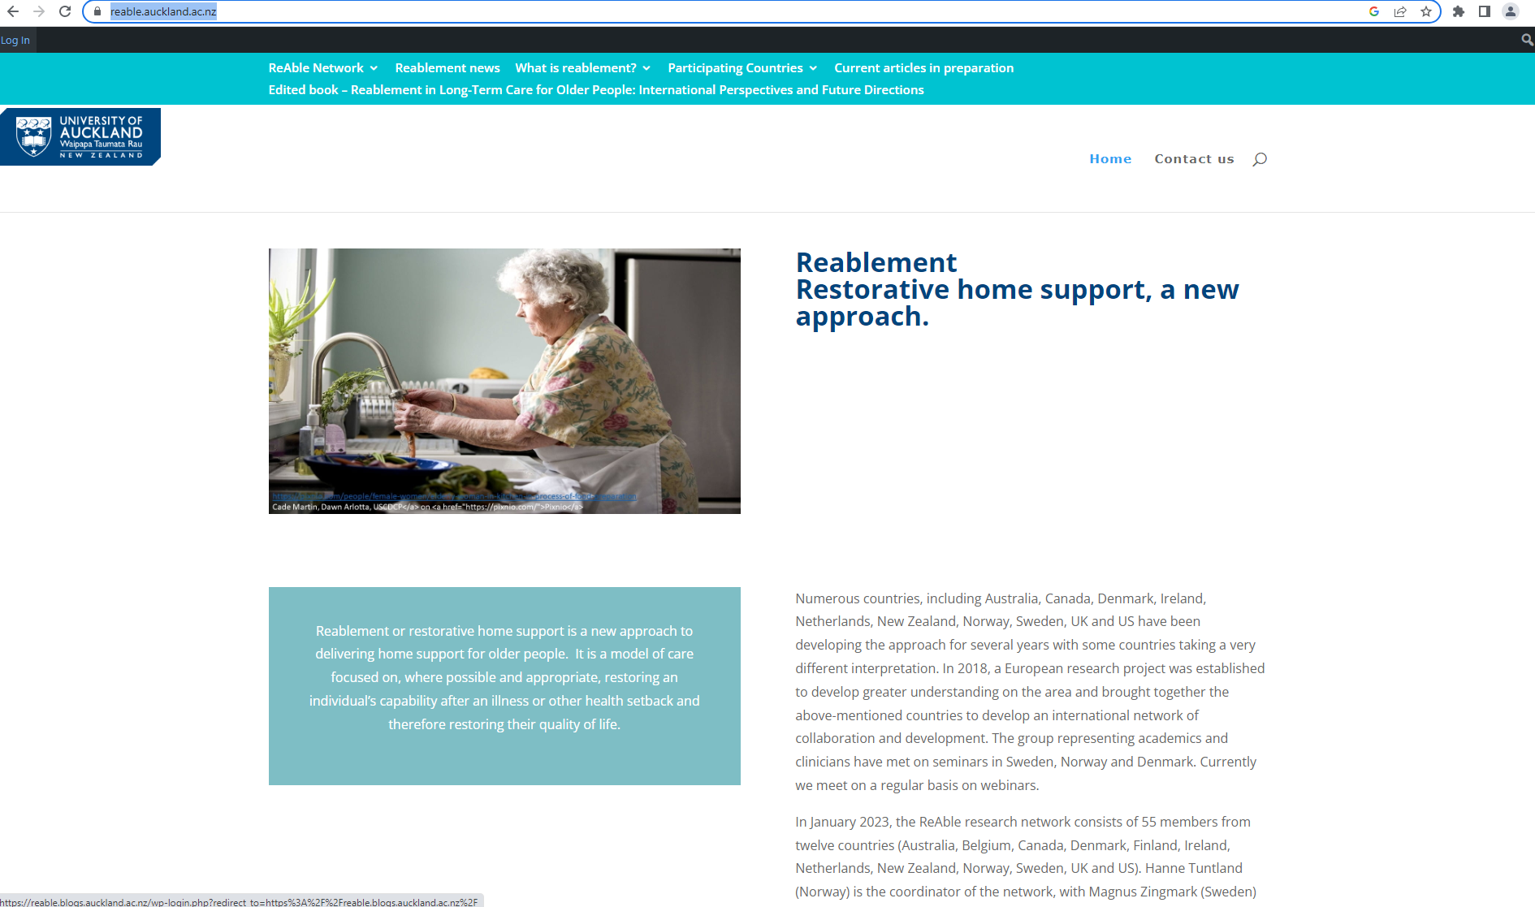
https://reable.auckland.ac.nz/
57 members from 13 countries; academics conducting research into reablement

Slide 15
Tak!

