Slide 1
ROBOTICS IN LTC: Myths
and realities

Slide 2
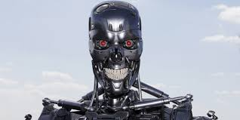
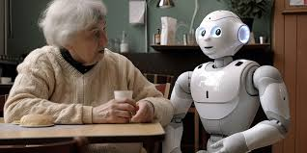
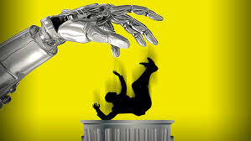
WHEN WE TALK ABOUT ROBOTICS IN LTC
SOME PEOPLE SEE THIS
A LOT OF PEOPLE SEE THAT

Slide 3
AND A STRONG BELIEF:
ROBOTS CAN’T GIVE ALL THE KINDNESS/ATTENTION/CARE/LOVE/UNDERSTANDING (you can choose one of these words or put your own, it’s up to you) THAT HUMANS BRING!

Slide 4
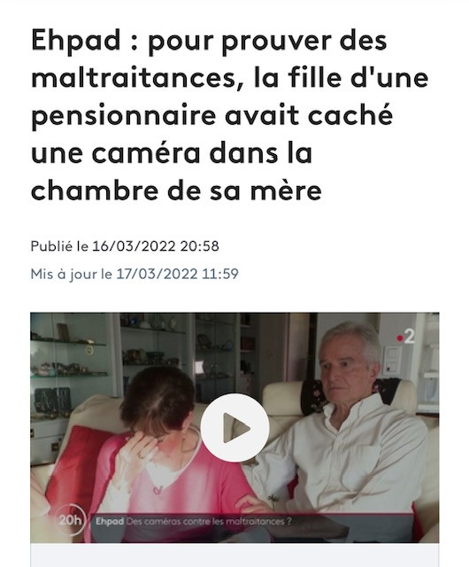
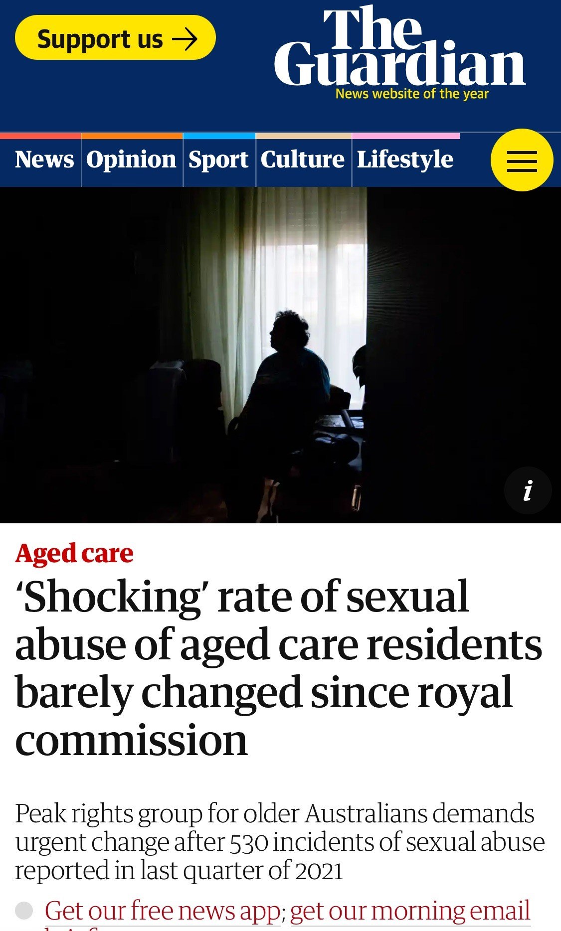
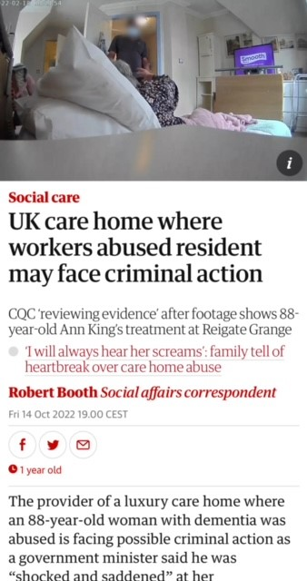
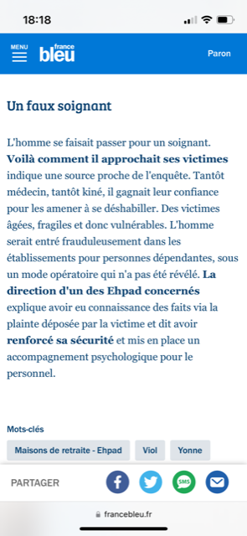
HAVE A LOOK….
Texte
NO HUMAN HURT BY A MICROWAVE OR COOKING ROBOT OR VACUUM CLEANER…

Slide 5
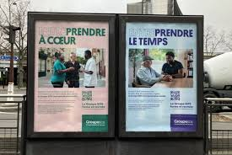
AND HOW TO STEAL WORK FROM MISSING WORKERS?
SHORTAGE OF CAREGIVERS / CARE SECTOR NEED WORKERS

Slide 6
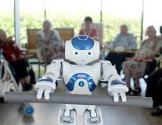
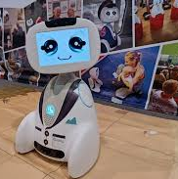
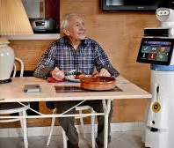
WHAT IS TRUE TODAY?
LES MUTUELLES DU BIEN VIEILLIR (South of France) EXPERIENCED 3 KIND OF ROBOTS
ZORA: very accepted, companion
KOMPAI: failed (big size scares people)
BUDDY: not on the market after 7 years of intense promotion

Slide 7
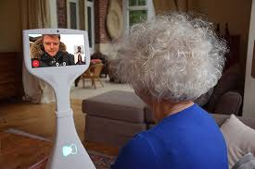
ROBOTS ARE GOOD COMPANIONS AT HOME
A THESIS IN 2023 « DOMIROB Implementation of telepresence robots in the homes of older adults : psychosocial impacts, acceptability, uses and recommendations for use”
Baptiste ISABET
Benefits for very isolated
Persons
But…don’t tell anyone..
..it’s a walking screen..

Slide 8
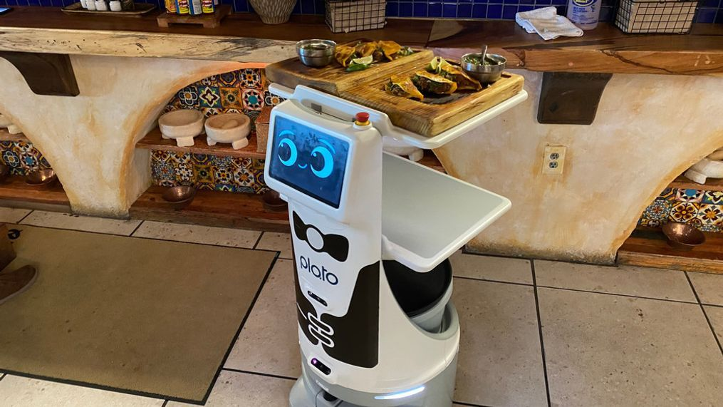
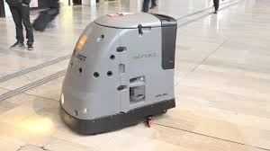
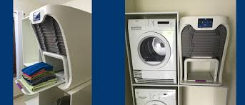
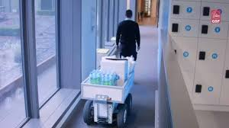
BUT TODAY, ROBOTICS IN EUROPE HELP LOW ADDED VALUE TASKS
PILLBOXES, LINEN, CLEANING
RESTAURANT, HEAVY LOADS…

Slide 9
TASKS AND SUPPORT
PREPARING DRUGS
LOW OR HEAVY OR ROUTINE SKILLS
CULTURAL ACTIVITIES
PREVENT
LIKE SUPPORTING CARE GIVERS AT NIGHT (OSO-AI)

Slide 10
AI
DIAGNOSIS
PREVENT AND ANTICIPATE

Slide 11
WHO PROMOTES ROBOTICS OR DIGITALIZATION?
THE CAREGIVERS
BUT WHAT DO WE AGREE TO LOSE?
MOMENTS OF HANDICRAFTS, ANIMATION?
MUSIC THERAPY? OCCUPATIONAL THERAPY?
CREATIVITY?
MAKING CONVERSATION? (CHAT BOT, VISIOCONFERENCES)
LIFE AND CARE PROJECT?

Slide 12
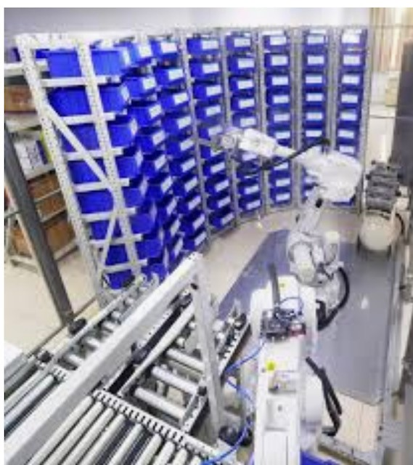
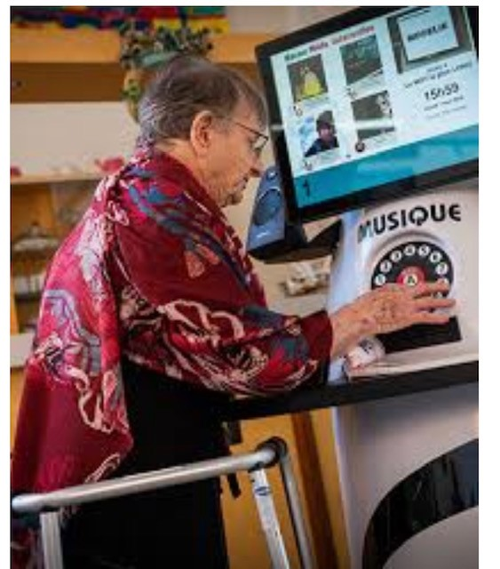
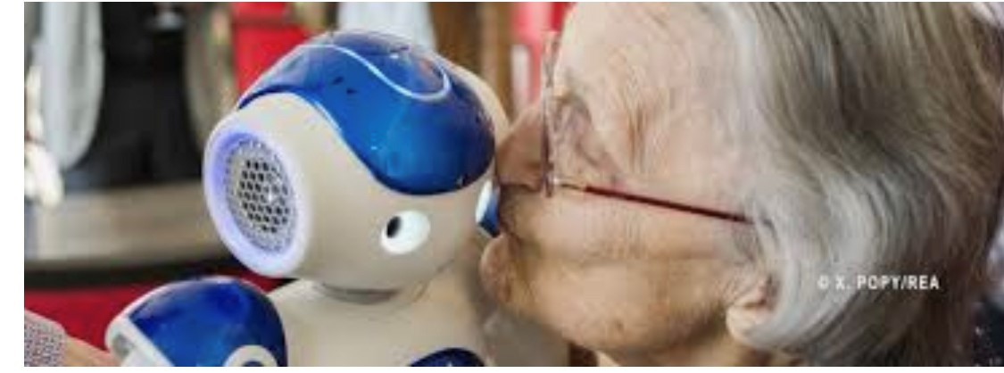
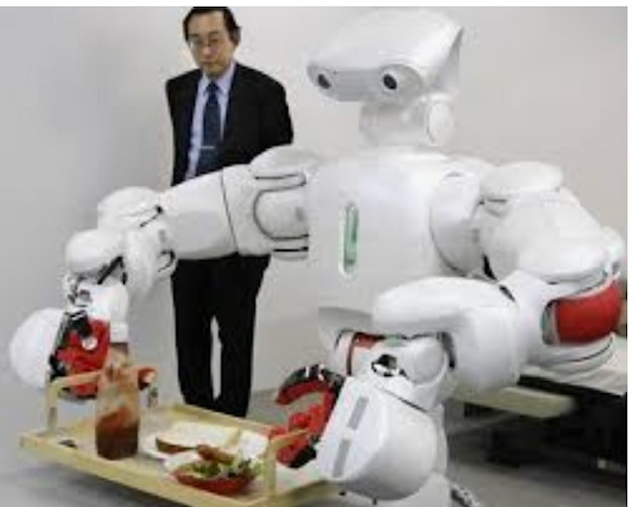
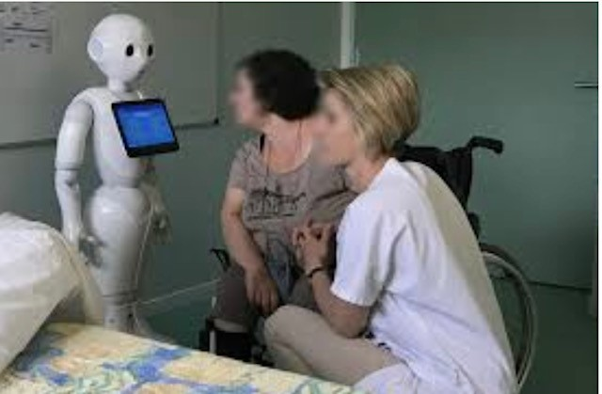
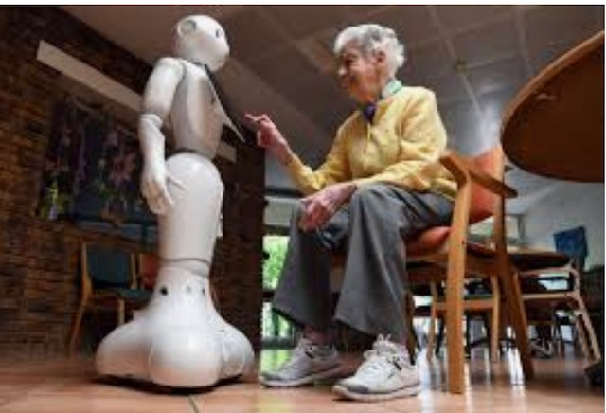
ARE THEY ANSWERS TO YOUR NEEDS?

Slide 13
WE CAN’T DO WITHOUT HUMANS IN CARE!
WHAT DO YOU THINK??

Slide 14
WELL-TREATMENT IN HOMES
CAN WE PROGRAM IT LIKE WE PROGRAM A COMPUTER?
« WE ARE NO MACHINES !»
« WE ARE WASHING MACHINES! »

Slide 15
ROBOTS
TODAY
COMPANIONS?
DOING LOW RATED SKILLS
TOMORROW
DOES IT COMPLAIN?
IS IT LATE?
IS IT ABSENT THIS MORNING? WITHOUT INFORMING?
DOES IT COMPLAIN BECAUSE IT HAS TOO MANY TASKS?
DO YOU HAVE TO PAY A SALARY?
DOES IT YELL AT SOMEONE? DOES IT SLEEP AT NIGHT? OR REST ON THE WEEK-END?
IS IT EXASPERATED WHEN SOMEONE TALK NONSENSE TEN TIMES AN HOUR? DOES IT LOCK PEOPLE UP? DOES IT FASTEN PEOPLE ON ARMCHAIR?

Slide 16
BUT WHAT CAN’T ROBOTS DO?
CHOOSE
MAKE CHOICES
BE RESPONSIBLE
BE MOVED, FEEL COMPASSION
LAUGH
SHARE A HUG
HAVE EMPATHY

Slide 17
TODAY ROBOTICS HELP US TO THINK ABOUT WHAT MAKE HUMAN BEING IRREPLACEABLE?
A WORLD OF TASKS VERSUS A WORLD OF RANDOM WHICH SUMMON OUR SENSE OF RESPONSABILITY, EMPATHY, DECISION
SUPERMARKETS VS LITTLE SHOP
15,000 JOBS DESTROYED (supermarket cashiers) in 20 years in France
Self-checkouts promoted by clients
But small shops still exist: why?

Slide 18
SO, TOMORROW?
THINK ABOUT THE SUPERMARKET CASHIER!!!!
WHAT DO NURSING HOME RESIDENT WANT? TECHNOLOGY? CONVIVIAL MOMENTS?
YES TO ROBOTS AND TECHNOLOGY IF THEY HELP US TO PROMOTE SOCIAL LINKS
YES TO ROBOTS AND TECHNOLOGY IF WE STILL PROMOTE ALL THESE LITTLE FRIENDLY MOMENTS IN EVERYDAY LIFE
YES TO ROBOTS AND TECHNOLOGY IF LIFE IN NURSING HOMES IS STILL MADE OF CURIOSITY, HOPE, DISCOVERING, SHARE…WALKING IN FORESTS, TOUCHING REAL LEAVES, SMELL REAL FLOWERS, LAUGH TOGETHER, EAT REAL GOOD FOOD..
A PLACE FOR EVERYTHING/EVERYONE AND EVERYTHING/EVERYONE IN ITS RIGHT PLACE: THE MANAGER IS THE KEY! AND HIS/HER STAFF
AT LAST, RESIDENTS WILL MAKE THE DIFFERENCE…

Slide 19
MERCI!
Jean-Marc BLANC
Directeur
jean-marc.blanc@i2ml.fr
THANK YOU FOR YOUR ATTENTION!
ΕΥΧΑΡΙΣΤΩ!

Slide 20
BUT!
DID I WRITE THIS PPT OR IS IT…
CHATGPT?????

