Slide 1
Informal carers’ skills and training: a tool for recognition and empowerment
Giulia Lanfredi, Project Officer
Eurocarers

Slide 2
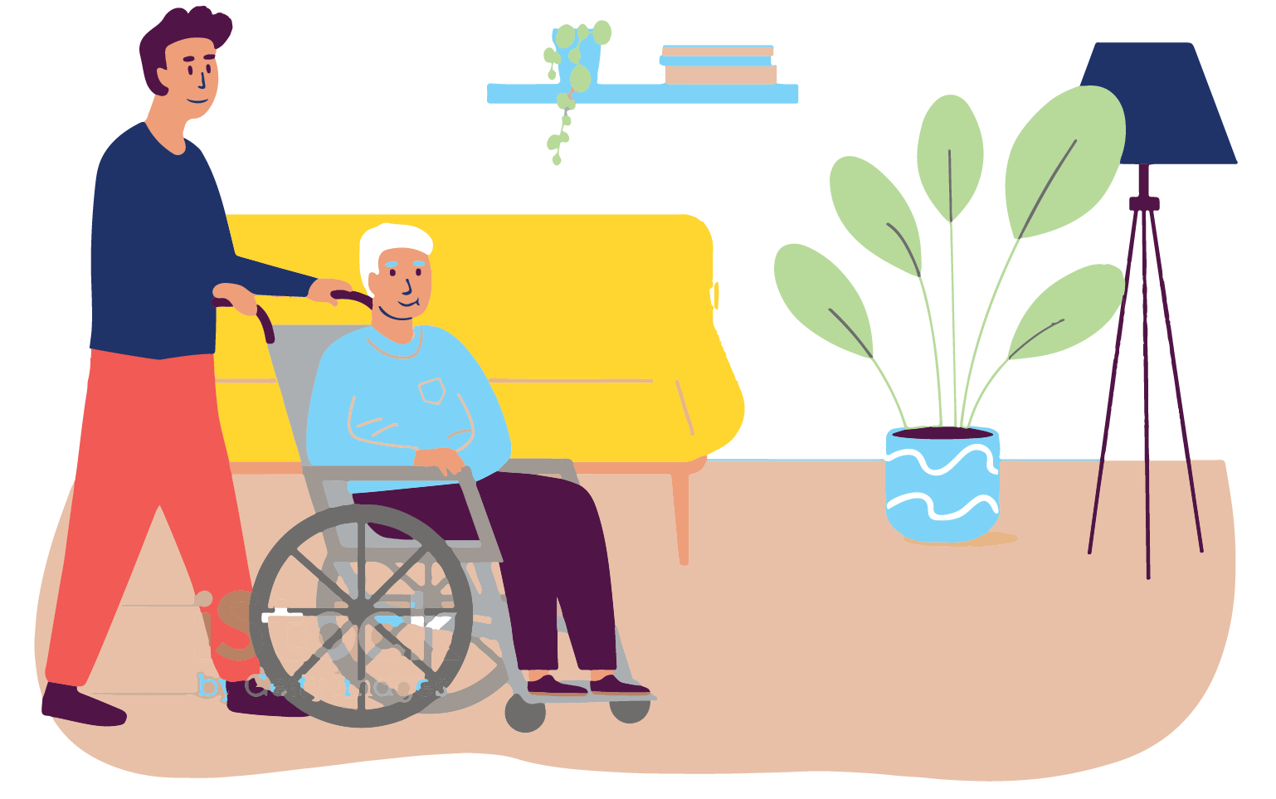
Who are informal carers/family carers?
A carer is any person who provides care - usually unpaid - to someone with a chronic illness, a disability or any other long-lasting care needs, outside a professional or formal framework
They typically are:
Family members
Friends
Neighbours
Aτυποι φροντιστές (Greek)
Caregiver familiare (Italian)
Mantelzorger (Dutch)
Cuidador informal (Spanish)
Aidant proche (French)
Pflegende Angehörige (German)
Notes:
Family members, friends and neighbours
The terminology varies from one country to another, I provided the translation in a few languages

Slide 3
How many informal carers are there?
44m people (18+) in the EU
80% of care providers at EU level, in FTE
Source: Eurofound 2020
Notes:
Eurofound estimates, based on the European Quality of Life survey, that at least 44 million people above the age of 18 years in the EU provide informal care more than twice a week (Eurofound, 2020a).
When using full-time equivalents, informal carers account for close to 80% of care providers at EU level.

Slide 4
The economic argument
vs 1.7% spent on professional LTC
Value of unpaid informal care in the EU:
2.5% of the EU GDP
A shift from informal to formal care would require an increase of 109% in the share of GDP devoted to LTC
No universal long-term care without informal carers!
Notes:
There is no universal quality LTC without informal carers --> they need to be part of the conversation, AND when we are engaged in conversations around LTC it is our duty to keep the role of informal carers (and their needs) in mind
However, their role and contribution to society is not fully recognised, and in several countries they do not receive adequate support for the unpaid labour they provide.

Slide 5
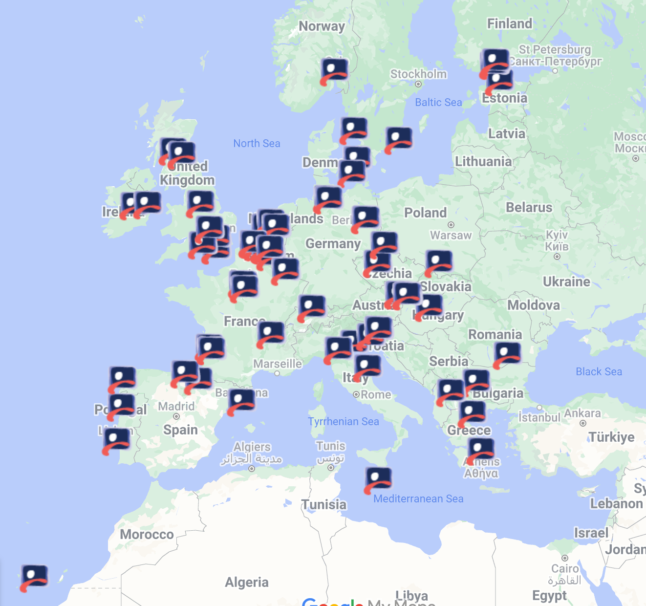
The Eurocarers network
75 members and partner organisations
25 countries represented
Carers’ grassroots organisations
Research organisations
Notes:
This is the reason Eurocarers exists
Eurocarers is a European network of organisations working with and for informal carers for more than 15 years
Gathering grassroots organisations and research organisations from the EU and beyond

Slide 6
Celebrating informal carers as key partners in LTC
Notes:
Eurocarers’ mission is to amplify the voice of informal carers in Europe, and work towards a society that recognises them as equal partners in care, alongside paid LTC professional – which is also the theme of this year’s communication campaign for the ECD taking place on 6 October

Slide 7
The carers movement: key asks
Recognition of the value of informal care: societal role + economic value
Integration in the care team on an equal footing as professional care workers
Empowering carers: having their voice heard
Care as a choice

Slide 8
How to support informal carers
Beyond contributing to efficient care of their loved ones, informal carers need to be supported to take care of themselves
Beyond the sole health area, informal carers need to be protected from socio-economic vulnerability
Beyond supporting others, informal carers should have their voice heard and contribute to policy design
Training to support carers in their carer journey, and provide specific skills they might need
Notes:
Training to support informal carers, so that they are better equipped and supported to fulfil their role, and there are gains in terms of quality of care provided.

Slide 9
Strengthening the skills of informal carers
1. Value and validate the skills that informal carers gain along their carer journey
Highlight transferability to the labour market: being a carer is not a ‘career break’
Reduce the risk of social isolation, improve carers’ social participation, help them re-enter paid employment
2. Provide education and training initiatives tailored to informal carers’ needs
Equip them to better fulfil their role, alleviate the caregiver burden
Equip them to better preserve their physical and mental wellbeing
Twofold approach
Improve the quality of care, and therefore the wellbeing
of care recipients

Slide 10
Informal carers’ skills needs
Research demonstrates that equipping carers with specific skills allows to improve the quality of care, notably:
Disease-specific knowledge
Skills related to daily life activities, such as transferring, bathing, dressing and feeding care recipients with safety
Digital skills, to be able to use technologies that support care, and access training opportunities
Skills to maintain the health status of the care recipient, and (if possible) facilitate rehabilitation
Skills for managing emergency situations
Skills for managing specific symptoms
Skills to take care of themself, manage stress and protect their own health
Notes:
Important because it took into account the main asks that the carers’ movement has been advocating for – good and comprehensive framework

Slide 11
Training for informal carers should be
Accessible
Designed with informal carers in mind (and with input from informal carers)
Practical and practice-oriented
A fair deal for informal carers
Also training for LTC professionals should focus on the role of informal carers, and how to work together as partners in care
Notes:
Informal carers do not exist in a vacuum --> LTC workforce need to be aware of the role of informal carers and be trained to work together with them, being equal partners in care --> importance of training and education for LTC workforce too --> IMPORTANT THAT PAID CARERS DO NOT IMPOSE TOP-DOWN APPROACH TO INFORMAL CARERS, BUT THERE IS A FAIR DEAL, EQUAL PARTNERS IN CARE -- ECD campaign this year focuses on this specifically

Slide 12
GivingCare (2020-2022)
https://givingcare.eu
Train formal and informal carers, personal assistants, and other health professionals, through the development of technical and digital skills, soft skills, through the design and implementation of an innovative Continuing Education Program and respective materials, based on independent learning modules
Countries:
Notes:
Added value of the training: Many of the modules focus on care professionals and informal carers working together: care professionals gain a better understanding of the role and importance of informal carers, AND at the same time informal carers gain key skills that better equip them to carry out their care work
Materials already available on the website in multiple languages

Slide 13
Eldicare 2.0 (2023-2027)
Countries:
https://eldicare2-0.eu
Notes:
The project is not eve halfway through so don’t have results to share yet
This project also has a focus on training and providing skills – in this case though it focuses on skills for professional LTC workers working with older adults
Updating their occupational profiles based on the actual needs of the current times (ageing population, increasing LTC needs, post-pandemic work)
Part of the focus of the training for LTC workers will be including interface with informal carers – awareness of the role of informal carers, and how to work with them as equal partners in care
Parallel session on Eldicare 2.0 taking place between 2pm and 3pm in Hall Apollon

Slide 14
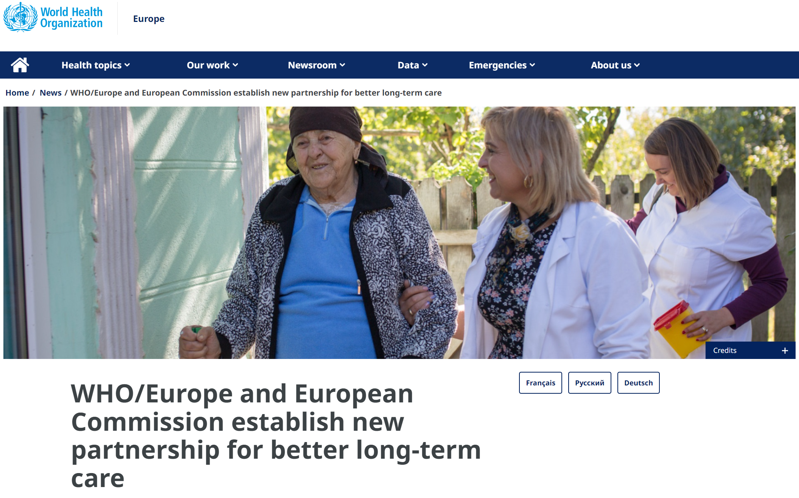
Open access online course for informal carers
2025
Notes:
Improve access to information and support tools for informal carers, modular and interactive structure
Objective 2 focuses on developing an open access online course for informal caregivers (OpenWHO), which can facilitate access to information, knowledge and skills required for the delivery of care and for supporting self-care and wellbeing of informal caregivers
Designed to include content that can be delivered via different media and in a variety of settings to increase accessibility, blending general content of global relevance with country specific information that can facilitate access to further support and additional resources.
Project is work in progress, we are currently developing online materials. Some of the content covered: being a carer, providing everyday care, managing symptoms and emergencies, caring for oneself, support available to carers

Slide 15
Thank you for your attention!
www.eurocarers.org
gl@eurocarers.org

