Slide 1





Digital Transformation in Health and Market Research
Dr Evagelos Korobilis Magas
Business and Innovation Consultant
September 2024

Slide 2


Who we Are
PRAXI Network is a unit of the Foundation for Research and Technology-Hellas (FORTH) and employs more than 40 highly qualified professionals from different disciplines and scientific fields.
30+ Years
Alongside companies, universities & research institutions, supporting the whole value chain that bridges the gap between research, innovation and commercialization.
www.praxinetwork.gr
September 2024

Slide 3

Praxi Network
Supporting innovation & technology transfer on a national and European level.
September 2024

Slide 4

Digital Transformation in Healthcare and Market Research
Overview:
Importance of adapting to rapid changes in the business environment – the key role of knowledge
Digital transformation in healthcare – challenges and benefits
Purpose:
A detailed examination of the role of market research in digital transformation in healthcare

Slide 5
Although the terms “information” and “knowledge” are often used interchangeably and in some cases are presented as synonyms (San Segundo, 2002), information and knowledge are two different but related concepts (Bierly et al., 2000; Boisot, 1998; Nonaka, 1994).
Knowledge “builds on information that is extracted from data” (Boisot, 1998, p. 12).
In any case, the bottom-line is that: knowledge is the only competitive advantage

Slide 6
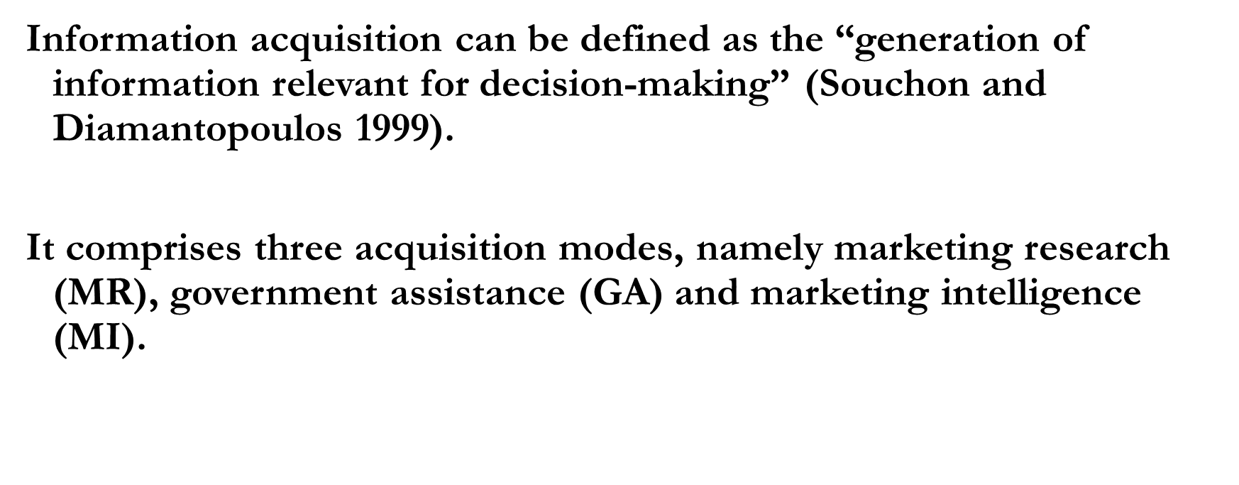
Information Acquisition
Information Acquisition

Slide 7
Market Research
“The gathering and analysis of data relating to market places or customers; any research which leads to more market knowledge and better informed decision-making” (Chartered Institute of Marketing).
It is formal, systematic and objective.
Only one in two firms on average conducts formal MR regularly (60-70% of large companies and 30-50% of SMEs).

Slide 8
Information-processing Behaviour
Individual Decision-maker
Information-processing Behaviour
High
Performance
Outcomes
Info
Acquisition
Info
Dissemination
Info Use
Global Business Environment

Slide 9
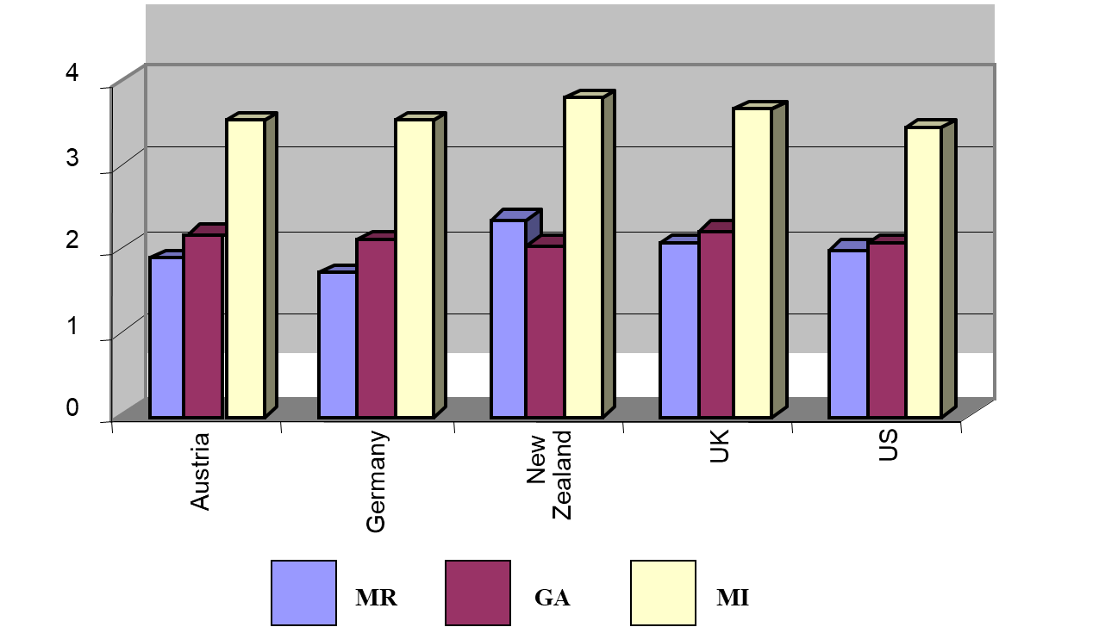
Information Acquisition

Slide 10
The Global Environment
Uncertainty
Turbulence
Instrumental
Acquisition
modes
Conceptual
Performance
???
Symbolic
Complexity
Conflict
Intensity
27 September 2024

Slide 11
Challenges and Considerations
Challenges:
Rapid technological changes.
Increased competition.
Changing consumer behavior.
Considerations:
Continuous learning and development.
Investment in research and development.
Building a culture of innovation within the organization.
27 September 2024

Slide 12
Strategies for the 21st Century
Emphasize Agility: Businesses must be able to quickly adapt to changes.
Focus on Customer-Centricity: Develop solutions that meet the evolving needs of customers.
Leverage Technology: Utilize data analytics, AI, and digital tools to enhance decision-making.
Sustainability: Adopt sustainable practices to meet regulatory requirements and customer expectations.
27 September 2024

Slide 13
Digital Transformation
What is Digital Transformation in Healthcare?
The integration of digital technologies into healthcare processes to improve patient outcomes, enhance operational efficiency, and provide innovative care solutions.
Involves shifting from traditional healthcare models to more patient-centered, data-driven, and technology-enabled healthcare systems.
27 September 2024

Slide 14
General trends/challenges in Healthcare
Why is Digital Transformation Crucial in Healthcare?
Rising Patient Expectations: Demand for personalized and convenient care.
Aging Population: Increased pressure on healthcare systems to manage chronic diseases, care for the elderly etc.
Global Health Challenges: The need for scalable, cost-effective solutions (e.g., pandemic response).
27 September 2024

Slide 15
Benefits of Digital Transformation in Healthcare
Enhanced Patient Care and Personalization
Remote Monitoring and Telehealth
Data-Driven Decisions and Predictive Analytics
Operational Efficiency
Patient Empowerment
Innovation in Treatment and Drug Development
27 September 2024

Slide 16
Benefits of Digital Transformation in Healthcare
Cost Reduction:
Telemedicine: Reduces the need for in-person visits and associated costs.
Efficient Resource Use:
Expanded Access to Care
Telehealth services provide access to remote and underserved populations.
Mobile health (mHealth) apps empower patients to manage their health independently.
27 September 2024

Slide 17
Identifying Unmet Needs:
  Conducting surveys and focus groups to understand gaps in care delivery and patient demands.
Data-Driven Decision Making:
  Using analytics and market intelligence to prioritize investments in new technologies.
Product Development:
  Informing the development of new healthcare solutions, such as mobile apps, wearable devices, or AI-driven diagnostics, based on patient and provider needs.

Slide 18
Conclusions
Market research, innovation, and digital transformation are crucial for success in the 21st century. All the above do not act in isolation from each other. It is rather the synergistic effect of their interplay that may have a significant effect on organisational performance.
Strategic integration of these elements can lead to sustainable growth and competitive advantage. However, a contingency approach is essential.
Final Thought: Businesses that innovate and adapt to market demands by making well-informed decisions will thrive in the dynamic global market.
27 September 2024

Slide 19






Many thanks for your attention!
Any questions please?
Dr Evagelos Korobilis Magas
Business and Innovation Consultant
  www.praxinetwork.gr
  korobilis-magas@praxinetwork.gr
September 2024

