Slide 1

Social Dialogue Affecting working conditions and skills
Gregor Tomschizek

Slide 2
Analysis: current status of working conditions in long-term care
Social dialogue at EU level with regard to qualifications in long-term care
Austrian care reform packages I and II as results of the National Reform Programme 2023

Slide 3
Analysis: current status of working conditions in long-term care
Social dialogue at EU level with regard to qualifications in long-term care
Austrian care reform packages I and II as results of the National Reform Programme 2023

Slide 9
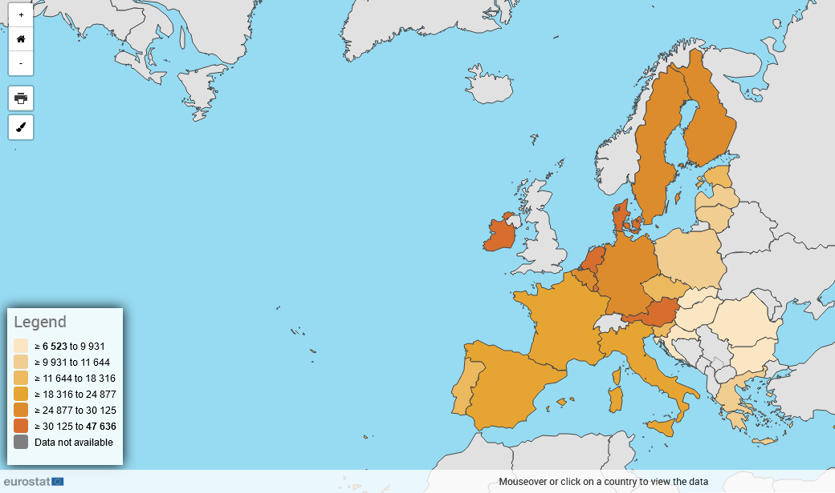
Mean and median income (in 2023)
by age and sex - EU-SILC and ECHP surveys (online data code: ilc_di03 )
(Total, Euro, Annual, Total, Median equivalised net income)
Source of data: Eurostat

Slide 10
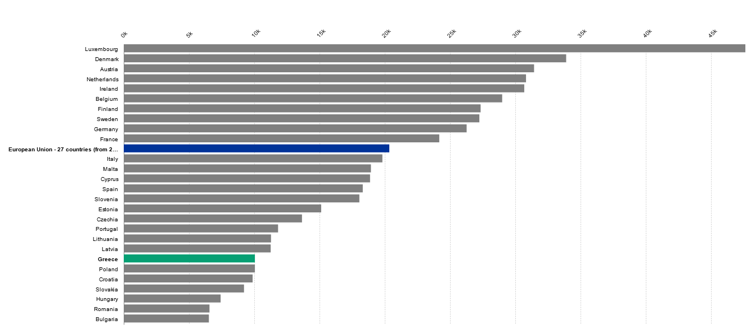
Mean and median income (in 2023) by age and sex - EU-SILC and ECHP surveys (online data code: ilc_di03 )
(Total, Euro, Annual, Total, Median equivalised net income)
Source of data: Eurostat

Slide 11
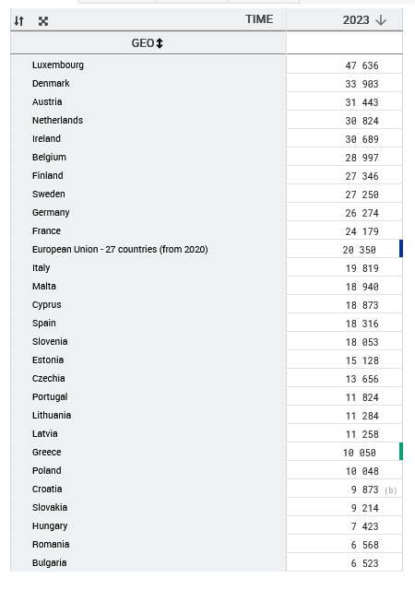
Mean and median income (in 2022) by age and sex - EU-SILC and ECHP surveys (online data code: ilc_di03 )
(Total, Euro, Annual, Total, Median equivalised net income)
Source of data: Eurostat

Slide 12
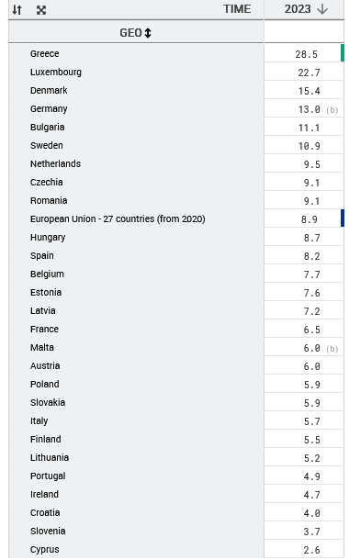
Housing cost overburden rate
EU-SILC survey
(online data code: ilc_lvho07b )
Source of data: Eurostat
How many % of the population lived in households that were overburdened by housing costs in 2023, i.e. they had to spend more than 40 % of their disposable income on housing?

Slide 13
Hourly earnings in social services (residential LTC and non-residential care) and healthcare as a proportion of national earnings, 2014, EU Member States (%)

Slide 14
 | Social Services | Residential LTC | Non residential LTC | Healthcare
Netherlands | 96 | 96 | 95 | 120
Luxembourg | 92 | 106 | 84 | 157
Austria | 92 | 92 | 93 | 111
Greece | 89 | 86 | 90 | 98
Romania | 89 | 95 | 78 | 179
Sweden | 86 | 86 | 85 | 107
Czechia | 85 | 87 | 80 | 113
Denmark | 84 | 86 | 83 | 103
Croatia | 83 | 82 | 83 | 112
Germany | 83 | 82 | 84 | 111
Poland | 81 | 86 | 76 | 101
Malta | 80 | 80 | 80 | 135
Finland | 79 | 82 | 76 | 104
Slovenia | 79 | 76 | 88 | 114
EU Member State average | 79 | 79 | 80 | 116
Belgium | 78 | 84 | 73 | 101
Slovakia | 78 | 75 | 95 | 107
Hungary | 77 | 77 | 76 | 99
Lithuania | 77 | 72 | 86 | 116
Cyprus | 75 | 55 | 94 | 116
Ireland | 74 | 70 | 76 | 114
France | 74 | 79 | 69 | 94
Portugal | 73 | 69 | 78 | 119
Latvia | 71 | 60 | 83 | 125
Spain | 70 | 69 | 72 | 137
Estonia | 65 | 64 | 66 | 116
Italy | 65 | 68 | 63 | 122
Bulgaria | 62 | 62 | 62 | 112

Slide 15
Analysis: current status of working conditions in long-term care
Social dialogue at EU level with regard to qualifications in long-term care
Austrian care reform packages I and II as results of the National Reform Programme 2023

Slide 16
Framework of Action on Retention and Recruitment in Social Services 2024
Education and initial training
Welcoming staff
Sufficient staffing levels
Valuing existing staff
Training, life-long learning and continuous professional development
Work-life balance
Gender equality and workforce diversity
Occupational Safety and Health
Managing change
Communication
Social dialogue and collective bargaining
Implementation

Slide 17
Analysis: current status of working conditions in long-term care
Social dialogue at EU level with regard to qualifications in long-term care
Austrian care reform packages I and II as results of the National Reform Programme 2023

Slide 18
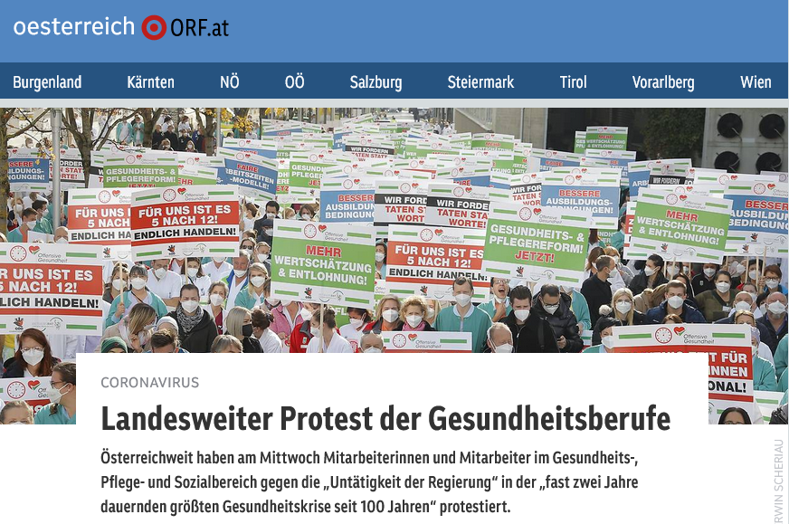

Slide 19



Das österreichische Pflegereform-Paket
(Austrian Care reform programme)
1. Ausbildung in der Pflege
(Education in the care sector)
2. Arbeit in der Pflege
(Work in the care sector)
3. Betroffene und Angehörige in der Pflege
(People affected and relatives in care)

Slide 20

1. Ausbildung in der Pflege (1)
(Education in the care sector) (1)
Wer eine Erstausbildung in einem Pflegeberuf macht, erhält einen Ausbildungszuschuss von zumindest 600 Euro pro Monat für Gesundheits- und Krankenpflegeschulen und Fachhochschulen.
Those doing initial training in a nursing profession receive a training subsidy of at least 600 euros per month for health and nursing schools and universities of applied sciences.
Personen, die an einer vom Arbeitsamt geförderten Ausbildung zur Pflegeassistenz oder an einer Schule für allgemeine Gesundheits- und Krankenpflege teilnehmen, erhalten ab 1. September 2023 ein Pflegestipendium. Das Pflegestipendium wird zumindest 1.400 Euro pro Monat betragen.
Persons participating in a training programme for nursing assistance or at a school for general health and nursing care funded by the employment office will receive a nursing scholarship as of 1 September 2023. The nursing scholarship will amount to at least 1,400 euros per month.

Slide 21
1. Ausbildung in der Pflege (2)
(Education in the care sector) (2)
Neben einer schulischen Ausbildung im Bereich Pflege wird es – vorerst als Modellversuch – in ganz Österreich eine Pflegelehre geben.
Es wird ein bedingter Rechtsanspruch auf Weiterbildung im Berufsleben geschaffen. Menschen in der Pflege können zukünftig in der Arbeitszeit eine weiterführende und/oder kompetenzerweiternde Ausbildung absolvieren.
In addition to school-based training in the field of nursing, there will be - for the time being as a pilot project - a nursing apprenticeship throughout Austria.
A conditional legal right to further training in working life is created. In future, people in care will be able to complete further and/or competence-expanding training during working hours.

Slide 22
2. Arbeit in der Pflege
(Work in the care sector)
Sonderzahlung in Höhe von jährlich EUR 2.000 für Gesundheitsberufe (vorerst für 2 Jahre)
Ab dem 43. Lebensjahr erhalten MitarbeiterInnen in der Pflege eine zusätzliche Urlaubswoche (Entlastungswoche)
Alle Beschäftigten in der stationären Langzeitpflege erhalten künftig pro Nachtdienst zwei Stunden Zeitguthaben
Special payment of EUR 2,000 per year for healthcare professions (initially for 2 years)
From the age of 43, employees in health care receive an additional week of leave (relief week).
All employees in residential long-term care receive two hours of time credit per night shift

Slide 23
3. Betroffene und Angehörige in der Pflege
(People affected and relatives in care)
Pflegekarenz
Zuwendungen für die Ersatzpflege
Pflegekurse für pflegende Angehörige
Ausweitung des Angehörigengesprächs
Angehörigenbonus (EUR 1.500,-- p.a.)
Förderung der 24h-Betreuung (EUR 800,-- p.M.)
Carer's leave
Payments for substitute care
Care courses for family carers
Expansion of the dialogue with family carers
Relatives' bonus (EUR 1,500 p.a.)
Support for 24-hour care (EUR 800 per month)

Slide 24
www.socialemployers.eu

