Slide 1
2024
The Impact of Scheduling Predictability, Fairness and Equity on the Employee Experience
www.workforce-edge.com
© 2024 Workforce Edge Consulting Inc. All rights reserved
Notes:
My name is Jillian Schwieger, I am the VP of international operations for Workforce Edge.
My focus in organizational learning, change management, workforce wellness and scheduling, planning and deployment. I am also a former nurse leader, educator administrator.
I am happy to be here today to share our data and experience as it relates to how staff scheduling impacts the employee experience and also to offer some suggestions for improvement.
Staff scheduling is not everyone’s favorite topic however, there is a real storm going on and I hope that I can give everyone great hope that scheduling can be improved, and in collaboration with employees, both leaders and staff can have a much better experience leading to better wellness and job satisfaction.

Slide 2
www.workforce-edge.com
© 2024 Workforce Edge Consulting Inc. All rights reserved
Notes:
We have been looking at the employee experience through the lens of scheduling for two decades.
Our work spans across Canada, the US and now Europe as we continue to collect data to help us identify leading practices in staff scheduling and the quality of the employee experience.
We find that staff scheduling is at a strategic junction between quality of care, financial stability and business sustainment.
Employees that are happier with scheduling services and have better schedules provide better care, tend to stay with their employers and require less sick time.

Slide 3
The Human Resource Crisis From the Employee Perspective
Schedule dissatisfaction
Last minutes changes in assignment
Working short to get vacation
Leader’s time is taken up by scheduling
Incorrect pay
Perceived employer unfairness
Lack of trust in staffing decisions
Lack of full-time work,
Burnout and injury
Inaccurate pay
© 2024 Workforce Edge Consulting Inc. All rights reserved
Notes:
We all recognize that current shortages and the ongoing staffing crisis is complex. Both leaders and employees are facing more chaos than ever before.
The workforce is exposed to extreme scheduling conditions that are contributing to higher sick time, burn out, and eroding the trust in their employers and satisfaction with careers in care giving.
With each engagement, we survey the workforce specifically about the scheduling environment and the wellness associated with that.
Our analysis shows that the chaos and hardship the workforce is experiencing can be alleviated when you take a holistic approach to optimizing the scheduling environment.

Slide 4
A Holistic Approach
Taking an integrated approach and breaking out of silos allows the key elements to be seen holistically, and an integrated ecosystem is key.
www.workforce-edge.com
© 2024 Workforce Edge Consulting Inc. All rights reserved
Notes:
What does this mean?
Staff scheduling has advanced – it deploys over 70% of the budget and often has little structure, KPIs, reporting or standardization.
Many organization even with expensive scheduling systems and software, still struggle with quality and standardization.
Technology – including AI do not fix the problem. There is no substitute for human compassion and understanding when it comes to the collaboration the workforce wants with leaders in regard to their schedules.

Slide 5
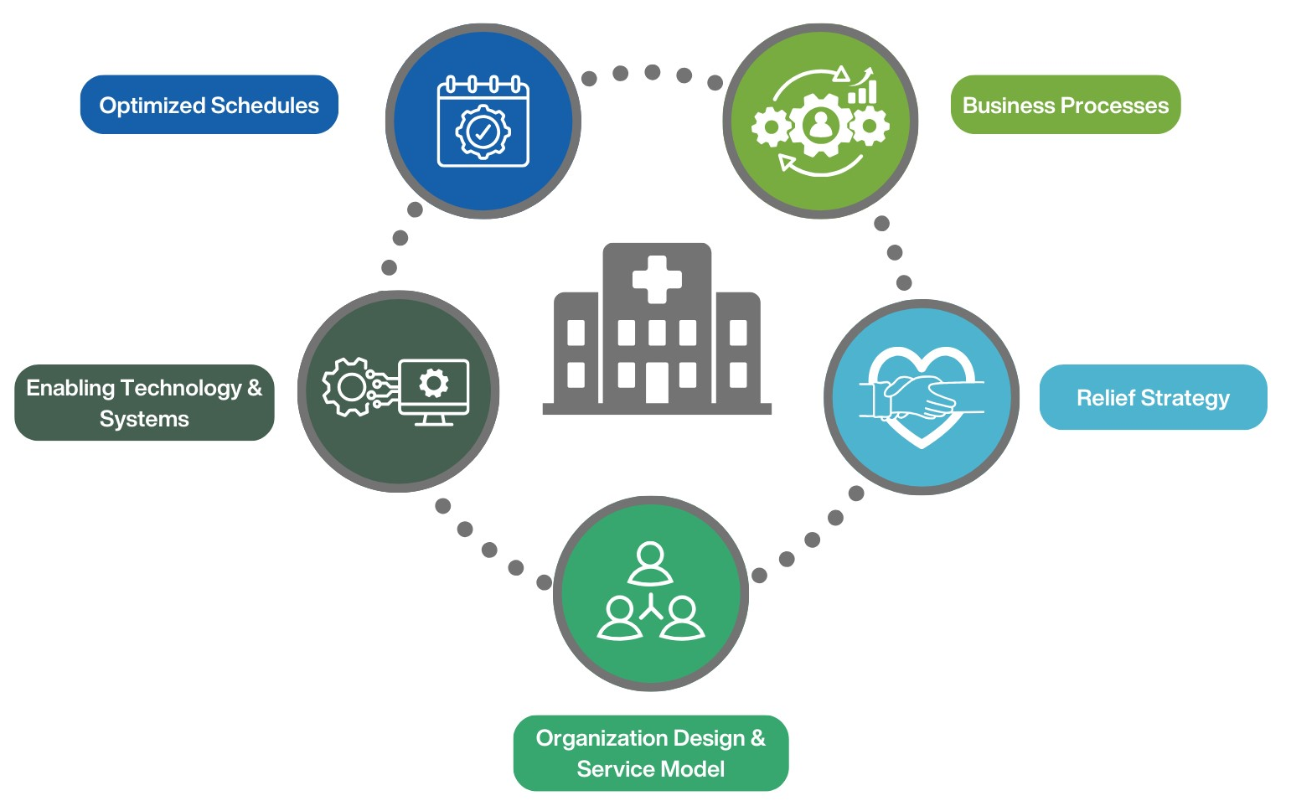
Key areas that negatively impact employee wellness
© 2024 Workforce Edge Consulting Inc. All rights reserved
Notes:
When we analyzed the data from the thousands of organizational data points, both qualitative and quantitative…… five areas emerged in which the workforces is saying that they overwhelmingly negatively impact their wellness.
Master schedules – they are too short, not enough rest periods, poor quality with short change overs and so on.
There is no strategy for relief and when vacation periods come – all staff have to work short in order to fill in so others can be away instead of using not enough back fill to cover vacations without working short.
Business Processes – things like vacation requests, shift trades, getting paid correctly – workforce often feels these procedures are unfair, inconsistent, not documented or transparent – perceive favoritism
Scheduling Service Design – managers and schedulers are in constant contact, taking up valuable leadership time, or staffing services does not exist at all and the tasks are left to leaders when we know that the workforce needs much more mentorship and support from leaders.
Scheduling technology not being used to match employees' modern needs or is being overused to automate things like calling out shifts with text messages to employees several times each day. In essence, over calling employees
These are the five major pathways in which employees and employers have multiple interactions per day.
The quality of these interactions depends on the ability to capture predictability, formalize flexible processes and to provide stable staff scheduling services to front line employees and leaders.

Slide 6
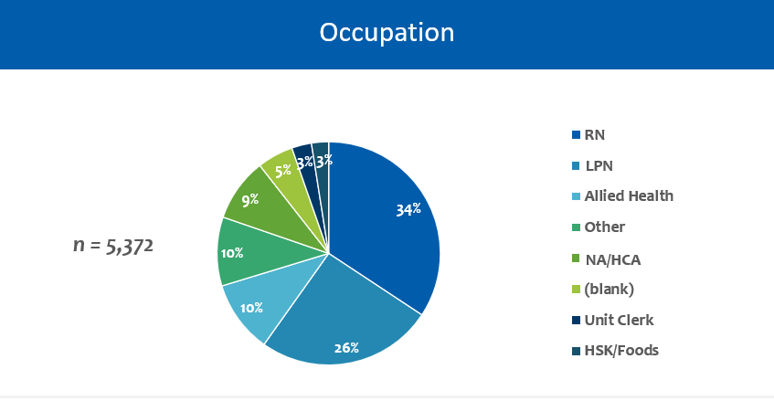
Occupation
© 2024 Workforce Edge Consulting Inc. All rights reserved
Notes:
A majority of responses came from the front line group of registered and practical nurses and care aids.

Slide 7
An example of how focusing on just one of those components can improve employee wellness
Baseline = prior to new RN rotation schedules
Post-implementation = 1-month post-implementation of new RN rotation schedules
© 2024 Workforce Edge Consulting Inc. All rights reserved
Notes:
Before and After Rotation and Relief Optimization and Implementation
100 percent of the nurse in this sample found the changed schedule fair and equitable

Slide 8
How far in advance do you know your schedule?
56%
Of respondents know their schedule less than 4 weeks in advance
n=2,714
How far in advance would you like to know your schedule?
84%
Would like to know their schedule more than 4 weeks in advance
n=4,075
© 2024 Workforce Edge Consulting Inc. All rights reserved
Notes:
Here is a look at schedule predictability
In this data, we see that just over half of the respondents have less than 4 weeks advanced notice of their schedules.
Where the opportuntiy lies is in the 84 percent would like to have more than 4 weeks notice of their schedule of work. (animate to follow)
Creating consistent schedules that rotate and are not re-created over short cycles less than 12 weeks creates an opportunity for more advanced planning on behalf of the employee and the employer.
For full time, part time and even casual staff – advanced scheduling of open shifts can happen as far back as 12 weeks when schedule quality is high, and this includes the need for relief embedded in the schedules to maintain the baseline.

Slide 9
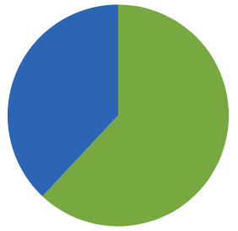
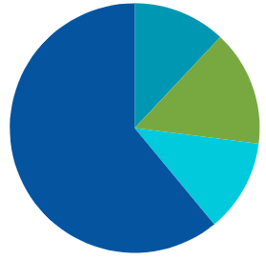
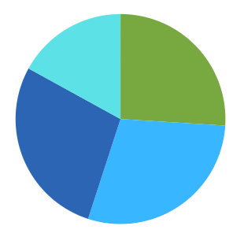
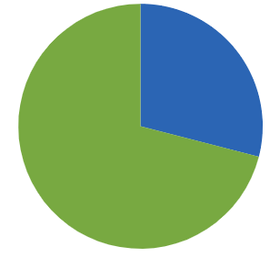
Last Minute Chaos
When I am re-deployed, I am sent to units I am unfamiliar with.
62% of respondents say scheduled that they are re-deployed to units where they are regularly not.
How far in advance do you get called/notified of the extra shifts you can pick up?
61% of respondents claim that they are offered shifts the day of.
12%
32%
38%
15%
68%
61%
38%
12%
Cumulative
n = 2,406
38%
Cumulative
n = 1,716
38%
When your schedule is changed how much notice do you receive?
> Half of respondents (55%) are advised of schedule changes with 3 days or less of notice.
At what frequency do pay errors occur?
Almost 1/3 of respondents point out that pay errors are frequent.
17%
26%
29%
28%
29%
71%
Cumulative
n = 1,775
Cumulative
n = 2,128

Slide 10
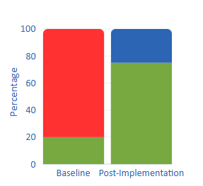
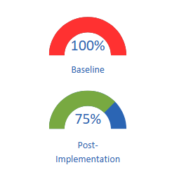
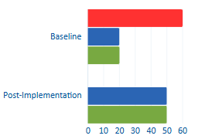
Personal Impact on Employees Before and After Improvements
Ability To Plan Ahead
Ability to have the rest and vacation time you need
Level of Energy at Work
60%
20%
20%
80%
75%
50%
50%
20%
20%
Notes:
Personal Impact
This data demonstrated the ability to plan ahead, have the rest and vacation time, and energy levels at work – this is a before and after measure.
The ability to plan ahead went from 80 negative to 75 positive
Rest and vacation 100 percent NO to 75 % yes
Levels of energy – 60 % very negative impact to 50 positive impact
These are all contributors to wellness and staff joy at work

Slide 11
High-Quality Schedules
Foundations for improved employee wellness
A Strategy for Relief
Advanced and Flexible Shift Filling
© 2024 Workforce Edge Consulting Inc. All rights reserved
Notes:
In conclusion:
Workforce wellness can be improved by focusing on an intentional design for your scheduling service.
Employees want more predictability, fairness, and stability
Staff scheduling is a key strategic function and workforce planning, scheduling and deployment can improve the current human resource crisis by implementing field tested to solutions to improve the employee experience.

Slide 12
https://workforce-edge.com
jillian.schwieger@workforce-edge.com
Montreal | Vancouver | New York
© 2024 Workforce Edge Consulting Inc. All rights reserved
Notes:
Close
Thank you for your participation today. On behalf of Workforce Edge, thank you for your time and participation. If you have any questions or if you wish to connect, please feel free to reach out.

