Slide 1
New EU curriculum for care givers - a new way to go?
Konstantina Leventi, Head of Policy, EASPD

Slide 2
EASPD – Who are we?
EASPD – European Association of Service Providers for Persons with Disabilities
Funded in 1994, represents over 20,000 social services and umbrella associations in Europe and not only;
Aims to promote equal opportunities for people with disabilities through effective service systems;
Aims to the full implementation of UN Convention on Rights of Persons with Disabilities;
Advocate for the provision of high-quality, and user-centred services running in an accountable, efficient and effective way.

Slide 3
Partnership for Skills in LTC - Timeline
Sept 2022
Launch of the EU Care Strategy: «Commission (…) promotes the establishment of a skills partnership under the Pact for Skills in the long-term care sector»
April 2023
Launch of the Large-Scale Skills Partnership in LTC: «The partners commit to train at least 60% of the long-term care workforce (3.8 million workers) every year by 2030. Training courses will focus on digital skills and person-centred care.»
March 2024
Care4Skills Project Start

Slide 4
Partnership for Skills in LTC – Key Aspects
ASSESS, PREPARE, ADDRESS the skills needs of LTC workforce to prepare them for future challenges (increasing demand, staff shortage, digital transformation, improving quality, etc.)
Objectives
Milestones, and activities to match the demand and supply of skills in the sector
6
Major trends
Technological developments in the LTC, are likely to affect jobs and skills needs.
1
3
5
Major stakeholders
Identification of key players and stakeholders that should be involved in the implementation of the strategy

Slide 5
Partnership for Skills in LTC – Major skills gap
The two main sets of skills identified by the Skills Partnership for the LTC sector
digital skills and person-centered skills.
Digital skills
(Assistive Technologies and Telecare)
Equip LTC professionals with the skills to make the most of the digital transition.
Person-centred skills
Equip LTC professionals with the skills to apply high quality person-centred support to those who draw on LTC services.

Slide 6
The junction point
The Skill Partnership intends to utilize the Blueprint to enhance its efforts in addressing skill needs in the LTC sector
Train at least 1,500 LTC professionals throughout the first year of the project, with many thousands more coming afterwards;
Identify existing and future skill needs in LTC;
Create European-wide & certified curricula and training programs for LTC professionals on digital skills and person-centered skills.
Establish a European Strategy for Skills in LTC for the years ahead, alongside a Sustainability Plan to make the most of the project's outputs.

Slide 7
Main Pillars
Rapid Response Training
First year: 1500 LTC workers trained
Research state of the art & future skills assessment
Identification of main skill gaps and LTC workforce needs
Desing & Pilot of new VET Curricula
Uptake of Training and Certification
Re-enforce of the Large-Scale Partnership
Development of new curricula
Pilot & Certification at EU level
Enlargement of the partnership in LTC

Slide 8
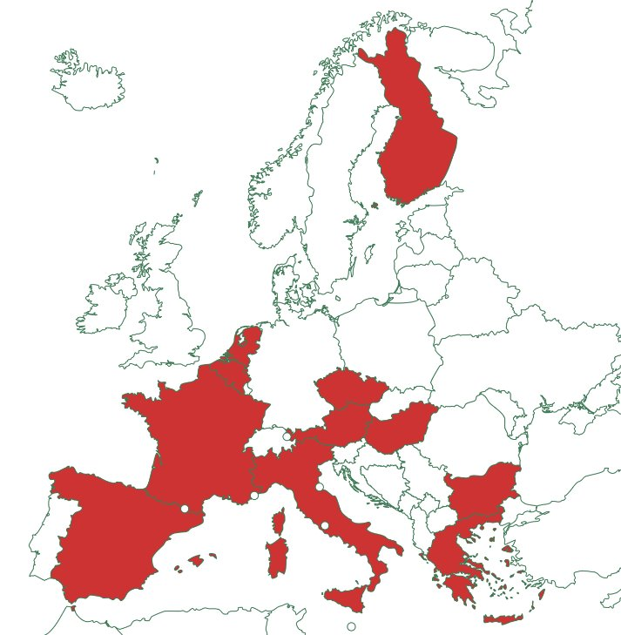
Care4Skills – Project & Partnership
27 partners
6 European networks (EASPD, EAN, EPSU, Social Employers, EVBB, SSE) 21 sector representatives, Service Providers, VET Providers, Higher Education Institutions & Certification body (UNIPSO, NASO, DAYANA, APSS, TUKENA, Taitotalo, NEXEM, IRTS-HDF, CAC, AMIMONI, AKMI, CAN, AIAS, APRO, Actiz, AVANS+, iSocial, JKUL, TUV HELLAS S.A., UH, MECSES)

Slide 9
Care4Skills – What’s next?
Development of a European Strategy for Skills in LTC
Ensure a Europe-wide sectoral approach to skills development in LTC
Expansion and Sustainability of the Large-Scale Partnership for Skills in LTC
Increase size and scope of partnership
Ensure implementation of multi-annual work plan

Slide 10
European Association of Service providers
for Persons with Disabilities
For further information:
www.easpd.eu
orazio.fiorini@easpd.eu
Konstantina.Leventi@easpd.eu
Thank you!

