Slide 1
Leadership – Structural Approaches
Professor Vic Rayner OBE
Chair of CPA, Chair of the Global Ageing Network
September 2024

Slide 2
Leadership
Structures within:
organisations
communities
global organisations
which are conducive to effective leadership

Slide 3
Organisational Structures

Slide 4
Effective leadership on an organisational level
Effective structures to support leadership include those that:
Make effective use of the different skills and learning styles that individuals bring to the workforce
Introduce a focus on reflection and learning
Focus on collaboration and strategies for stability during times of change
In order to achieve the above, it is also necessary to have good communication within and between different levels in the organisation

Slide 5
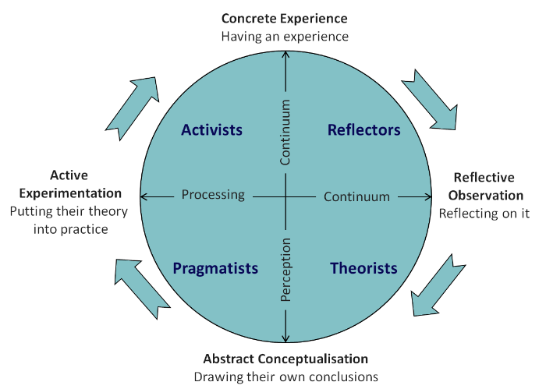
Effective leadership on an organisational level
Make effective use of the different skills and learning styles that individuals bring to the workforce
Appropriate delegation of tasks – My Home Life England Professional Support and Development Programme for senior care home staff members finds that delegation improves team cohesion and creates important boundaries around leadership roles which can be complex and demanding¹.
Honey and Mumford² have developed a tool to understand the learning styles of your workforce (Activist, Reflector, Pragmatist, Theorist), making it possible to support them effectively
1. https://myhomelife.org.uk/wp-content/uploads/2023/11/MHLE_PSDP_Annual-Report_2023.pdf
2. https://ukdiss.com/examples/models-in-education-and-training.php

Slide 6
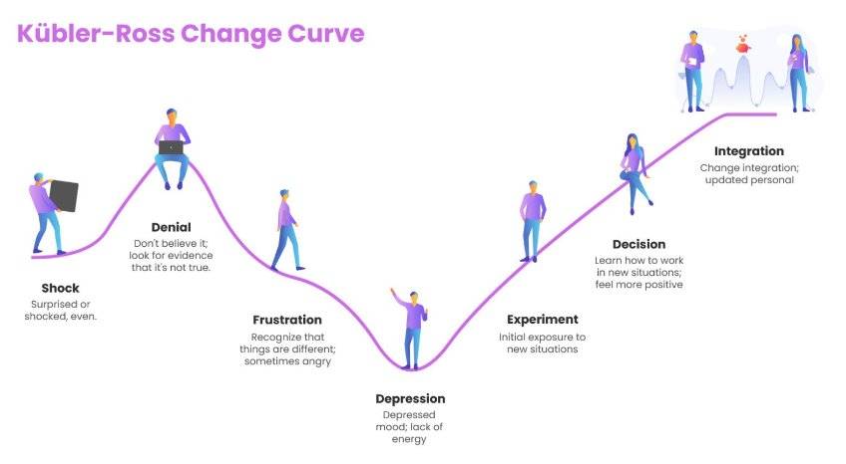
Effective leadership on an organisational level
Introduce collaboration and strategies for stability during times of change
Top-down change initiatives often follow the Kubler-Ross Change Curve¹. Reducing the ‘depression’ stage is key to successful change.
Create open communication with reluctant workforce members and listen to their feedback – they might be right.
Designate ‘champion’ staff members (eg Digital Champions²) who are open to change and can help you pave the way to integration.
https://online.visual-paradigm.com/infoart/templates/kubler-ross-change-curve/
https://www.skillsforcare.org.uk/Support-for-leaders-and-managers/Managing-a-service/Digital-technology-and-social-care/Digital-champions.aspx

Slide 7
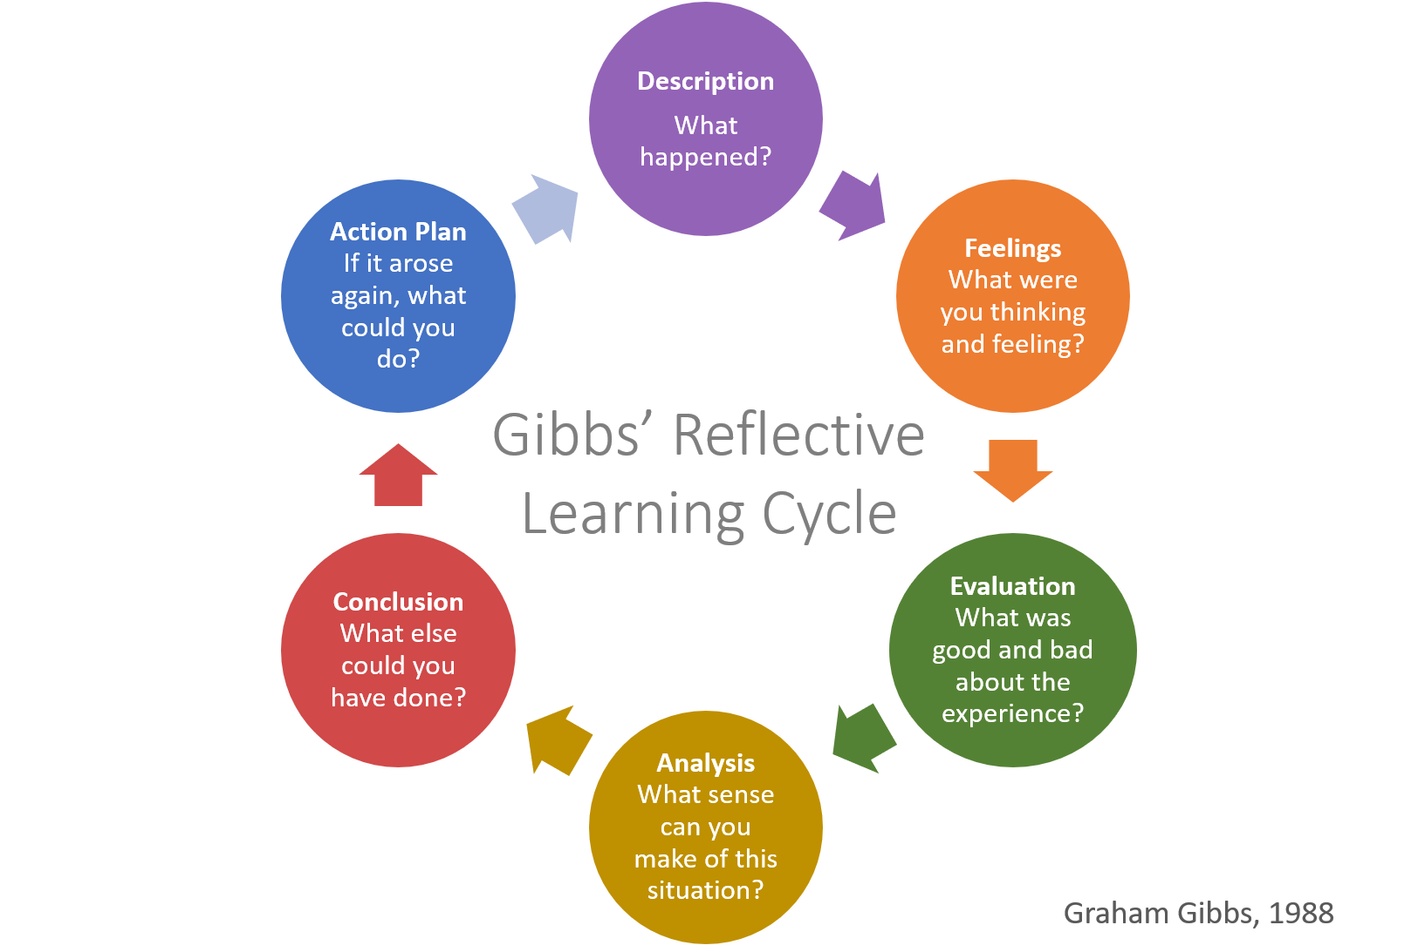
Effective leadership on an organisational level
Implement structures conducive to reflection and learning
Embed reflection into processes and projects using tools such as Gibbs’ Reflective Learning Cycle¹.
Be sure to implement and follow-up with the Action Plan developed in future.
https://www.slideshare.net/slideshow/elegant-digital-marketing-agency-presentationpptx/256482092

Slide 8
Community Structures

Slide 9
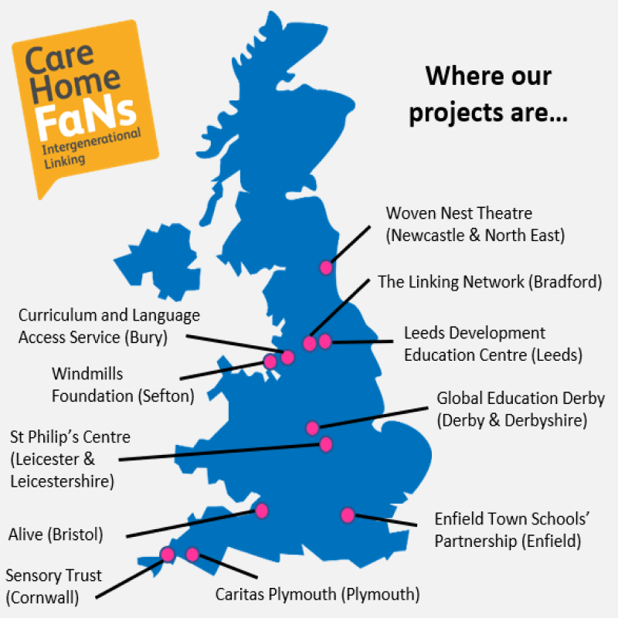
Community Leadership
Building broader community structures
Implementing initiatives which involve the local community, to improve cohesion and drive community connection.
My Home Life¹ runs a series of programmes designed to this end under the title ‘Intergenerational Linking’
Care Home FaNs (Friends and Neighbours) – encouraging and enabling care settings to develop connections with their local community schools, businesses etc
11 original locations, with resources online to help anyone else get involved.
https://myhomelife.org.uk/intergenerational-linking/

Slide 10
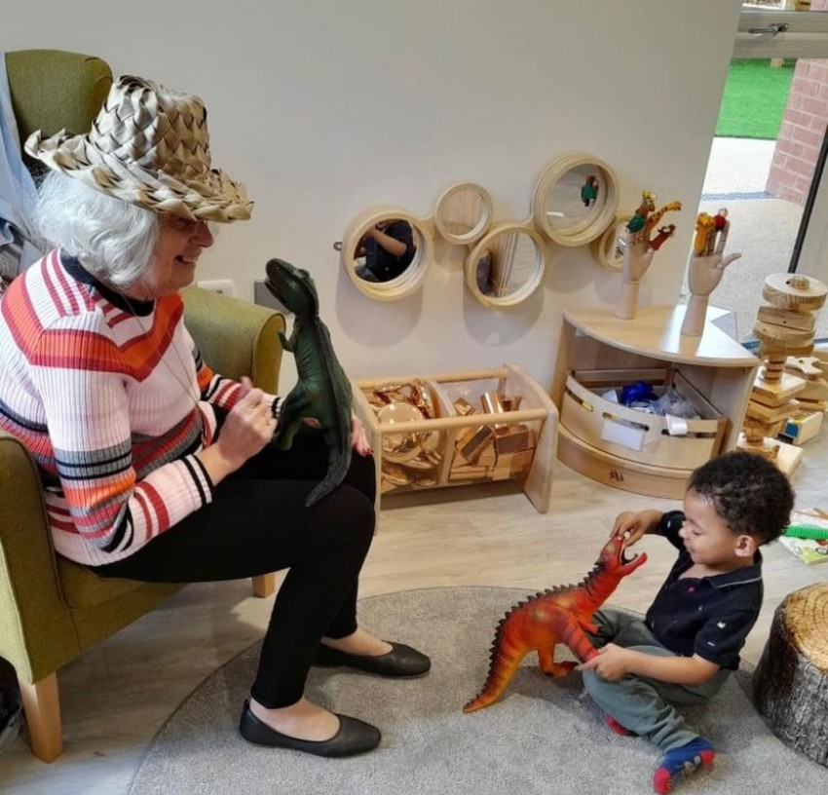
Community Leadership
Benefits of building community initiatives
Drives intergenerational connection¹
Provides older people with a sense of energy, companionship and purpose
Provides younger people with a sense of citizenship, opportunities for youth social action, and positive relationships with older people
Seen also in Belong Villages Chester² (right³), integrated care village – a nursery inside a care home. Creating a hub for community connection.
https://myhomelife.org.uk/intergenerational-linking/
https://assets.ctfassets.net/hr3c1u4s8hbm/6EzRb99rC4SbrdCMRk1cIH/a7d148286a10657c9a69aecdcdcda5dd/nursery_impact_report_year_one_sept_2023_web_spreads__1_.pdf
https://www.belong.org.uk/locations/chester/facilities/thenursery

Slide 11
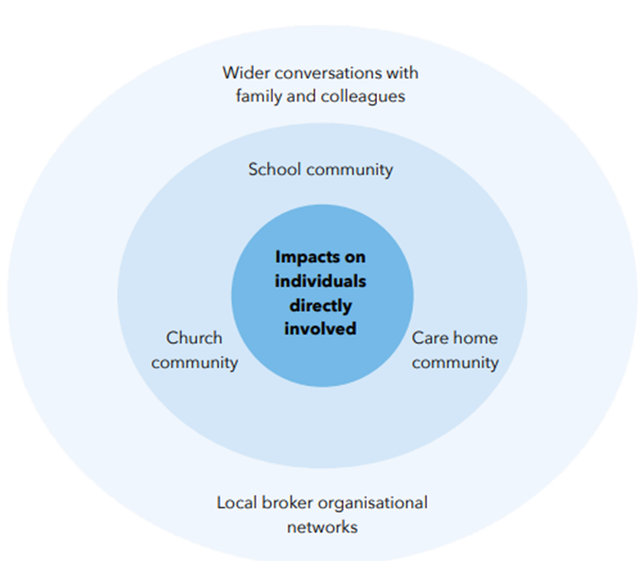
Community Leadership
Benefits of leadership for the community as a whole – ‘ripple effect’ (right) ¹
Fosters greater understanding across sectors and age groups
Instils an awareness and enjoyment of social action in young people
Beneficial impact on families – opportunity to all enjoy being part of something together
Creates a sense of connection and community cohesion, which is important for young and older people
These benefits are often embedded - participants continued the work after the project concluded
1. https://myhomelife.org.uk/wp-content/uploads/2023/02/FinalReport_InterGenLinking-1.pdf

Slide 12
Global Leadership

Slide 13
Global Leadership
Like many other leadership contexts, structures which encourage communication is key with teams across different countries and time zones
A strong collective voice is also necessary to cut through on a global level

Slide 14
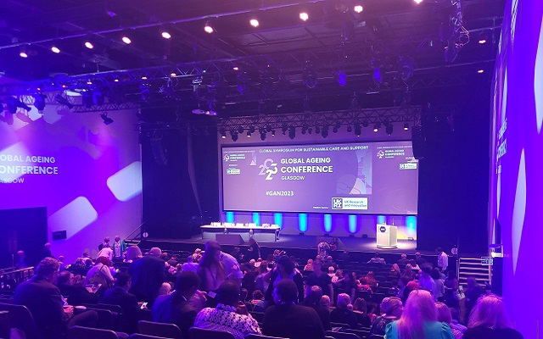
Global leadership
Building trust and rapport
Listen to those who know their own countries/localities best.
Ensure effective communication through regular online meetings, in-person conferences, and written communications where time zones clash
Building trust in your collective voice
Building a global vision and voice for care¹ which can support conversation about care in all localities
Global Ageing Network ‘Call to Governments’ 2023 – a paper outlining the major issues facing older people’s care, and concrete steps that international governments can take to improve them.
Adopting positive positions on issues such as person-centered care and a rights-based approach, advocating for the voice of older people in all global contexts
https://globalageing.org/wp-content/uploads/2023/03/2023-CALL-TO-GOVERNMENTS-PAPER_Global-Ageing-Network.pdf

Slide 15
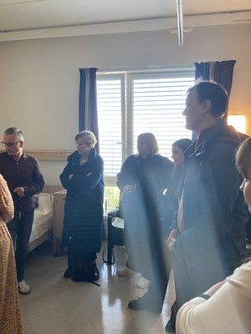
Global leadership
Benefits to individuals
Strengthening local practice - learning from one another, sharing ideas
Recent NCF trip to Norway with some of our members and partners, to learn about the latest developments in care technologies and see them implemented.
Benefits to the global care community
Leading the sector by modelling and promoting approaches informed by a very wide range of providers and experiences
Global Ageing Network webinars – putting spotlight on and giving voice to different countries’ issues and practices¹.
https://globalageing.org/webinars-and-rountables/

