Slide 1
EU Future Skills Panorama powered by Cedefop 2023 Skills Forecast
Ilias Livanos, Expert
Department for VET and skills
Honorary Associate Professor, University of Warwick
Notes:
Intro

Slide 2
Dataset: what is the skills forecast?
    01
A unique database
    02
A single methodology - harmonised and comparable data
    03
Skills: proxied by occupations and qualifications
    04
Supply: qualifications of working-age population/labour force
    05
Demand: employment by sector, occupation, qualification
    06
42 sectors 41 occupations 3 levels of qualifications
    07
Projections for 10-15 years, EU-27+

Slide 3
Potential users include:
Educational providers (higher education, apprenticeships, vocational education, life-long learning)
Companies (identification of further shortages, in-house training)
Social partners (protect the interest of their members)
Public authorities (design of migration policies)
Individuals who are making career choices

Slide 4
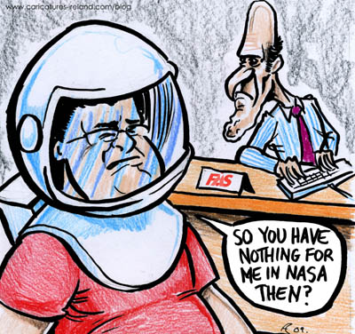
Why do we need a skills forecast?

Slide 5

Foundations of the 2023 Skills forecast
The ‘most likely to happen’ scenario
  Covid
  Geopolitical tensions
  Energy prices
Impacts on
skills & jobs
Greening assumptions

Slide 6

EU (ageing) workforce
2022-35: average annual growth rates
(darker=stronger, white/grey=negative or zero)

Slide 7
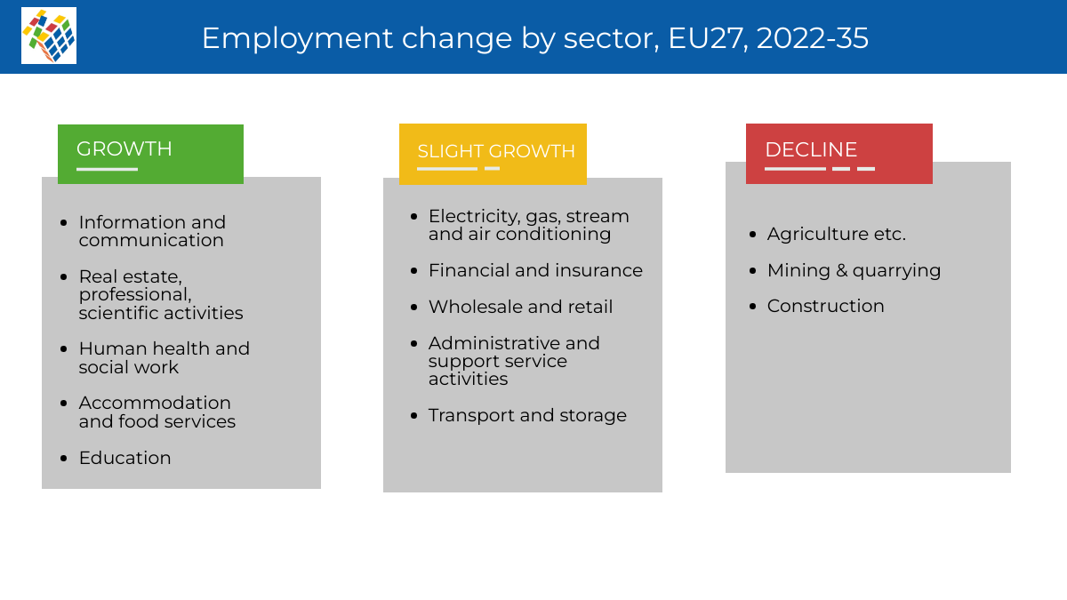
>=0.5pa <0.5pa

Slide 8
Total job openings

Slide 9


Labour shortage index
Powered by Cedefop skills forecast
Future shortages
Score from 1 to 4
Higher score – higher the shortage
Equal weights
Arithmetic average
Estimated by skill level
Extended to sectors
Demand
employment growth
Supply
replacement rates
Imbalances
hiring difficulties

Slide 10
Labour shortage index
2 – 2 - 3
Twin transitions are due to create shortages
Replacements need a careful design
Future supply will suffice
Employment becomes skills intensive
4 – 1 - 2
3 – 4 - 1
2 – 4 - 2
Note: the three elements are shown inside the bars

Slide 11
Labour shortage index
1 – 2 - 2
Strong impacts of technology
Interpersonal skills not easily substituted
2 – 2 - 4
Note: the three elements are shown inside the bars

Slide 12
Labour shortage index
Technology as a substitute of labour
Specialised knowledge needed
Note: the three elements are shown inside the bars

Slide 13
Labour shortage index
4 – 2 - 2
Strong future shortages
But … skill shortages?
2 – 3 - 4
Note: the three elements are shown inside the bars

Slide 14

The impact of AI on employment
900 000 new jobs to 2035
R&D, communication
HealthCare seems AI-proof
Small (5%) impact on jobs
Country variations
Caveats apply
AI could widen capital

Slide 15


Ilias.LIVANOS@cedefop.europa.eu
Skills-Forecast@cedefop.europa.eu
#skillsforecast

