Slide 1


Thinking Out of the Box
Dan Levitt
BC Seniors Advocate

Slide 2
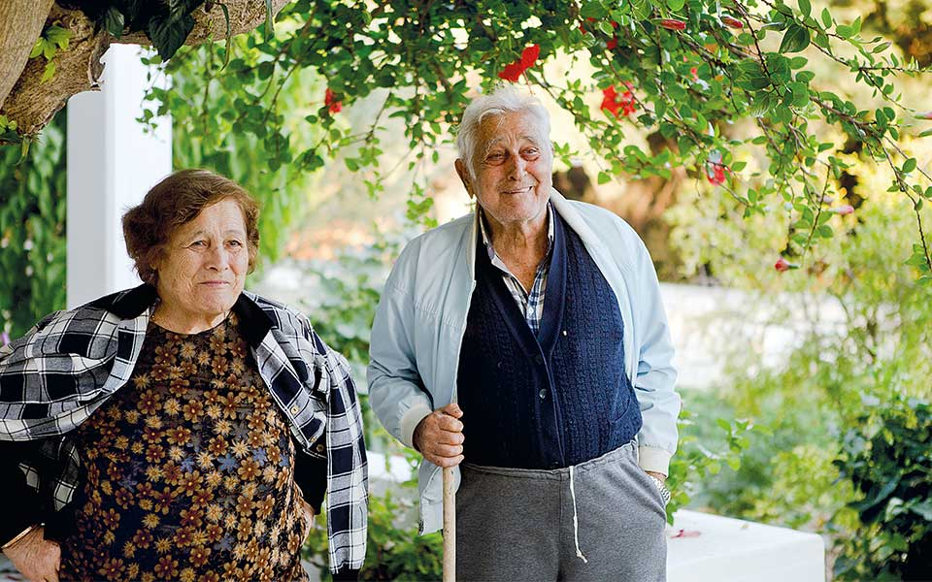
​

Slide 3


Slide 4


Slide 5
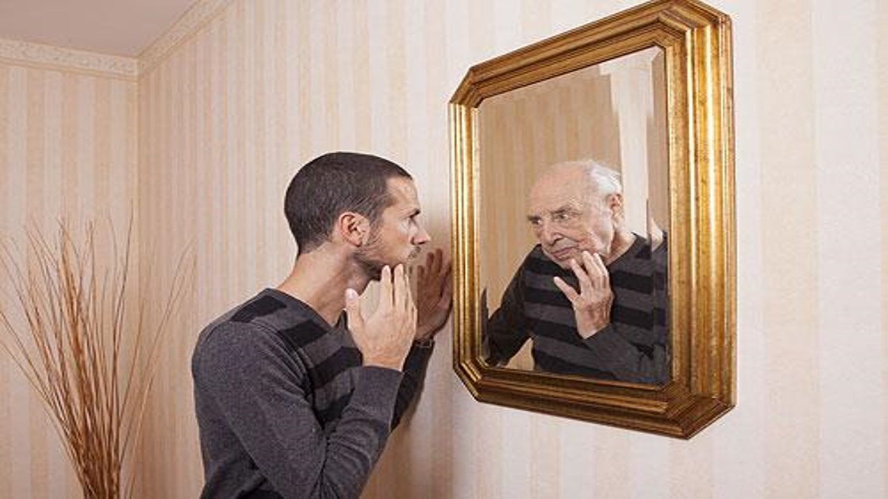

Slide 6
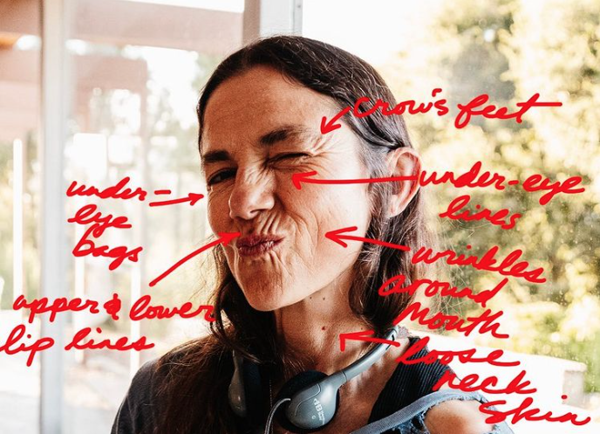

Slide 7


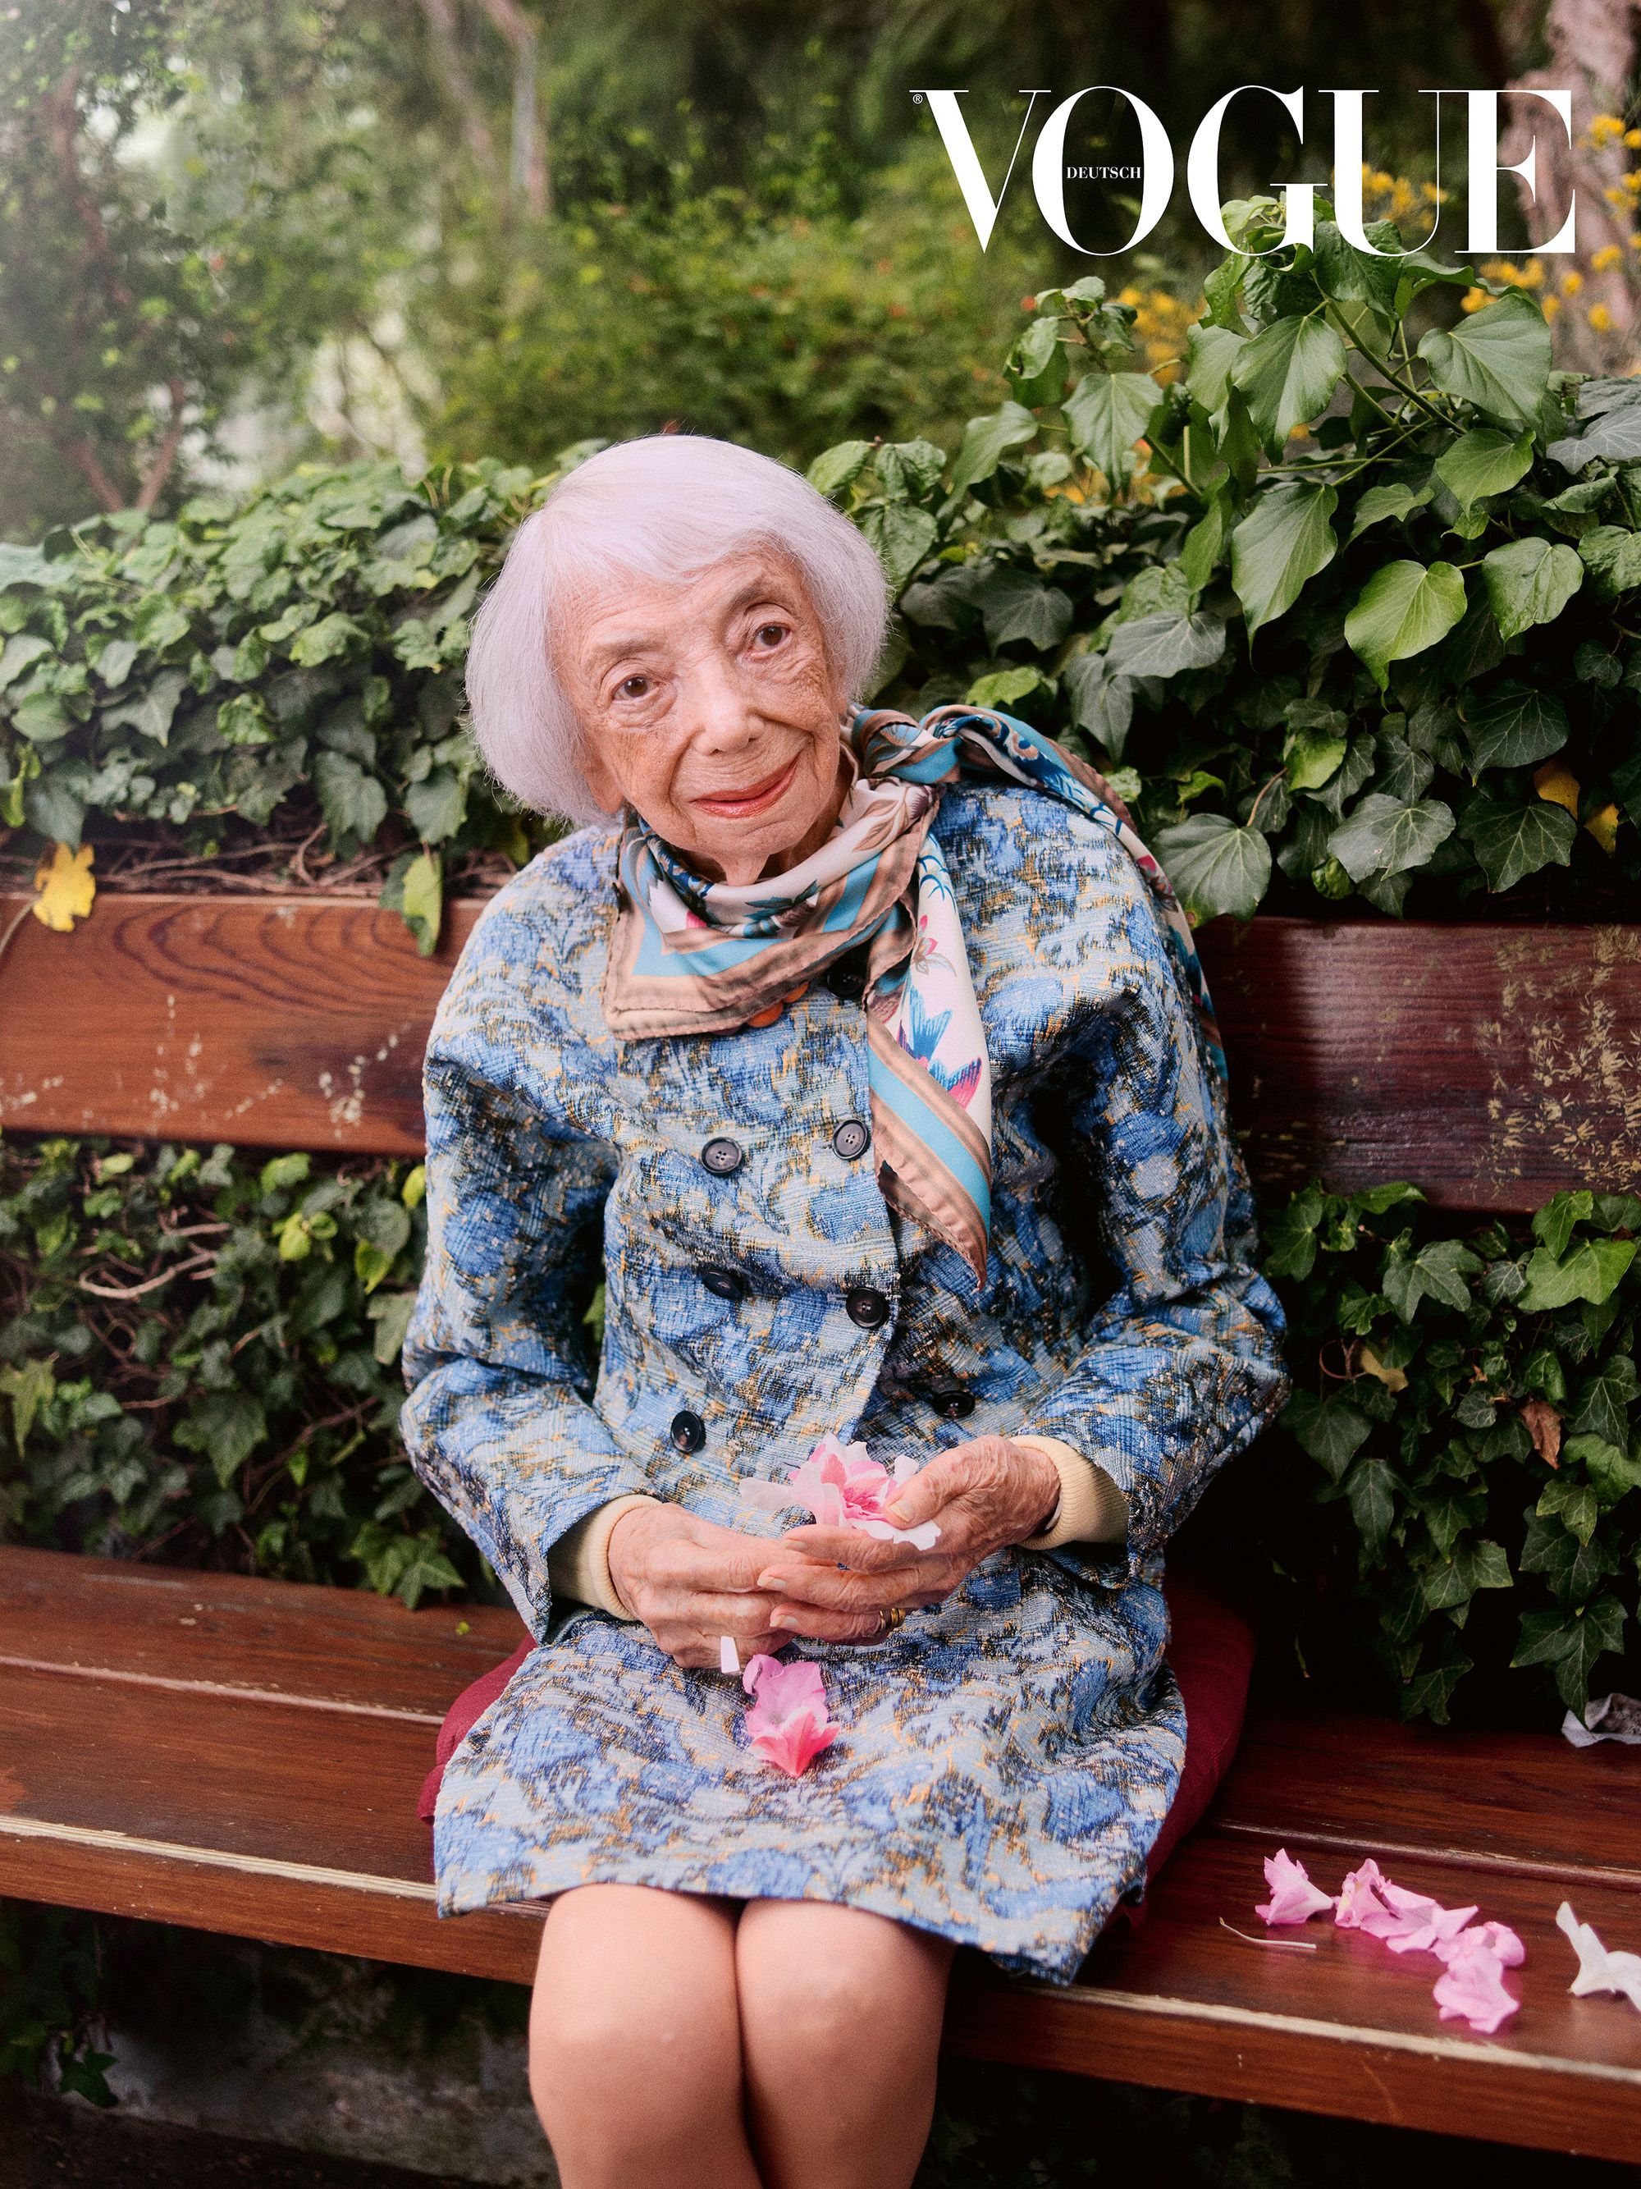

Slide 8
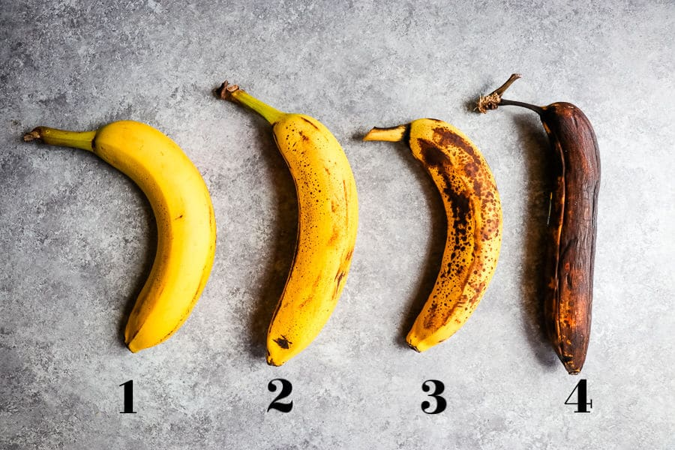

Slide 9
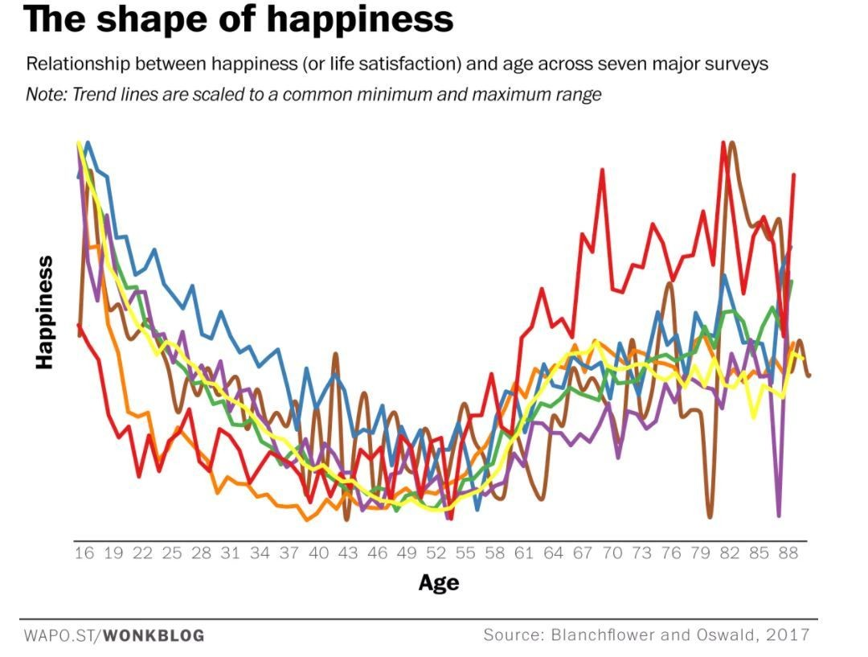

Slide 10
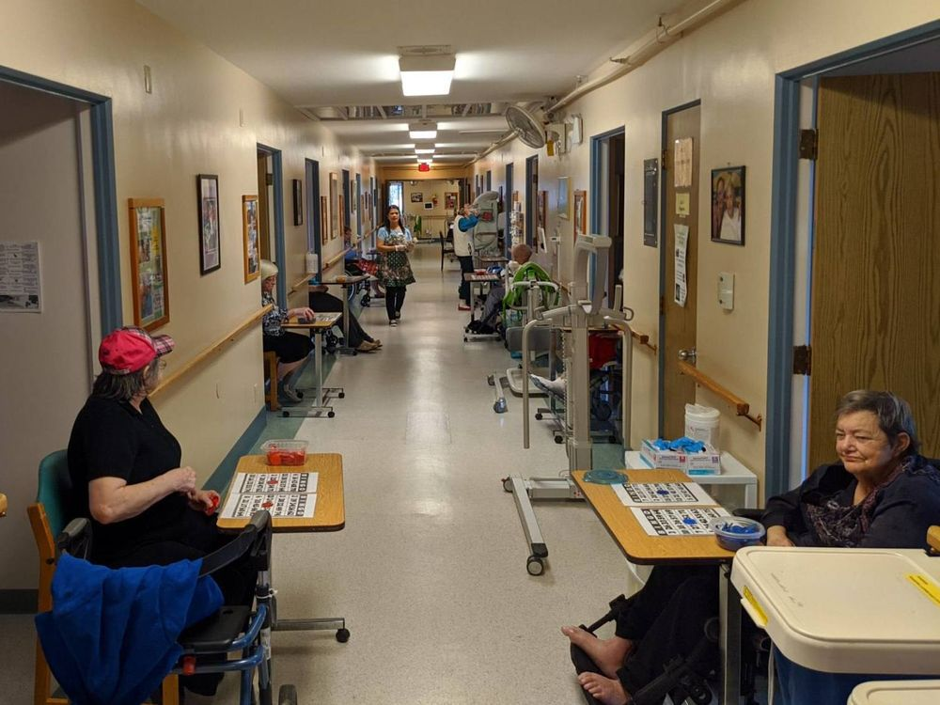

Slide 11
5 Generations of building care homes and residences

Slide 12
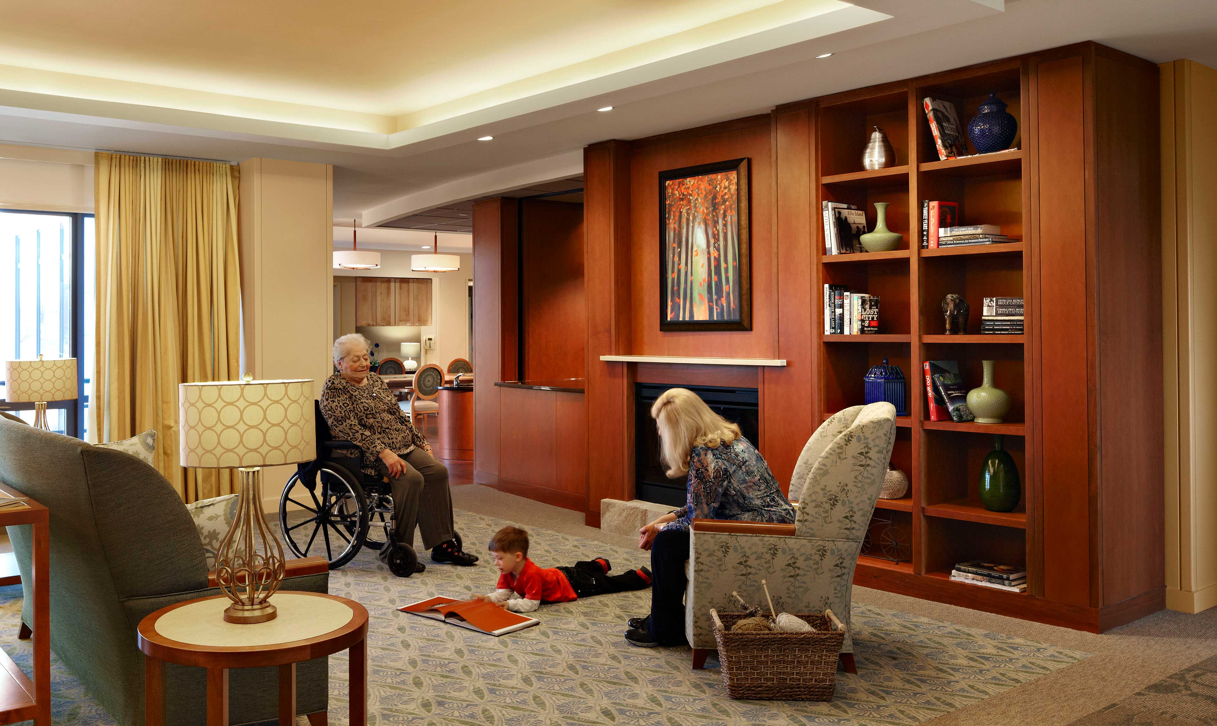

Slide 13
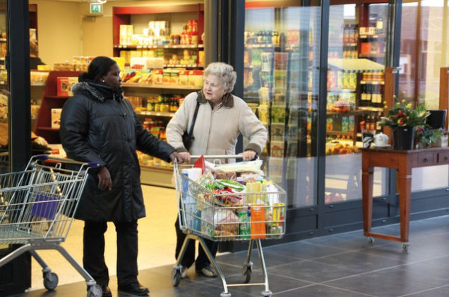

Slide 14
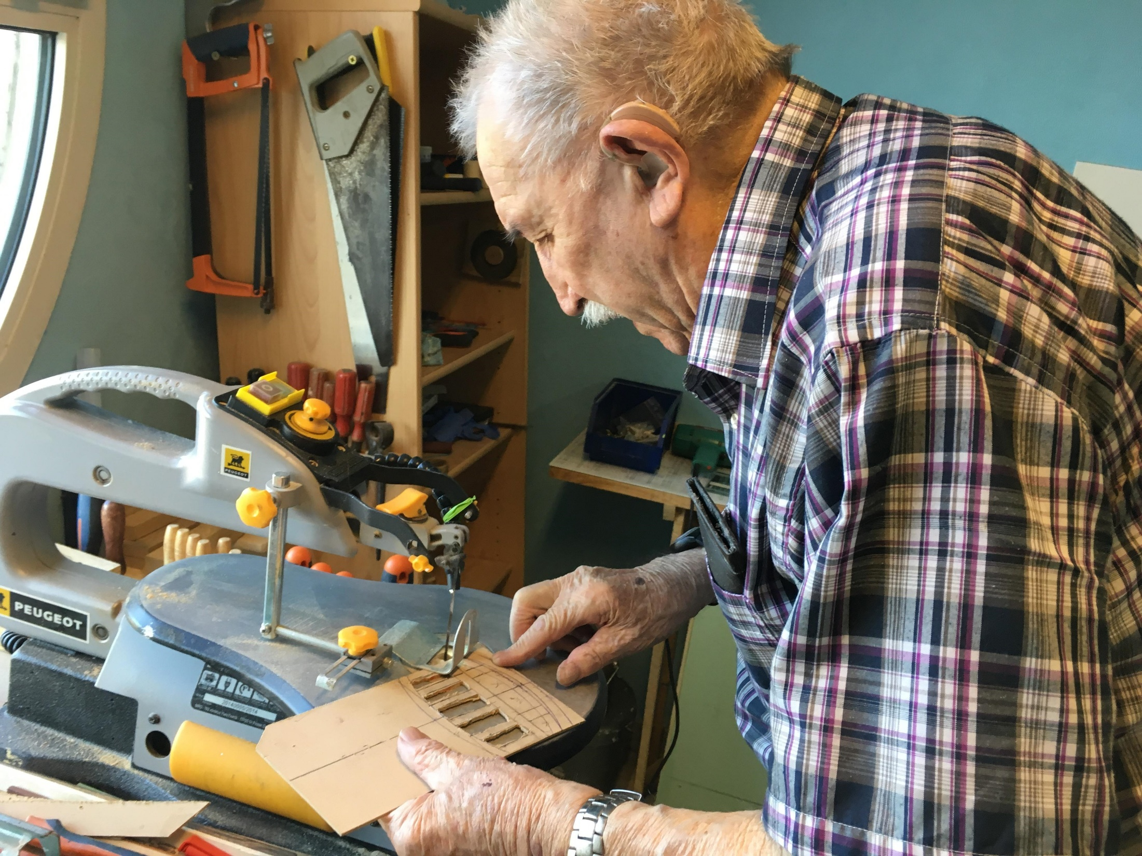

Slide 15
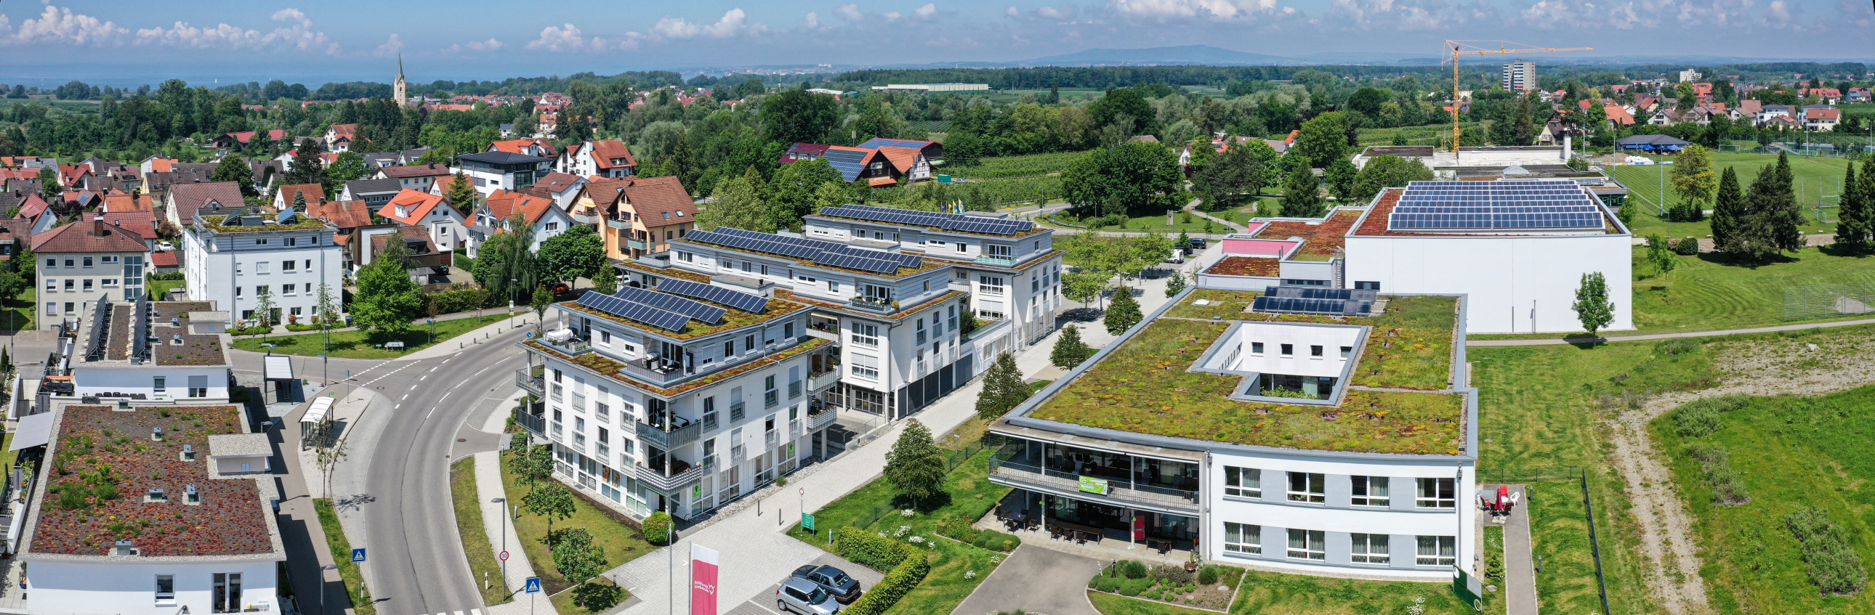

Slide 16
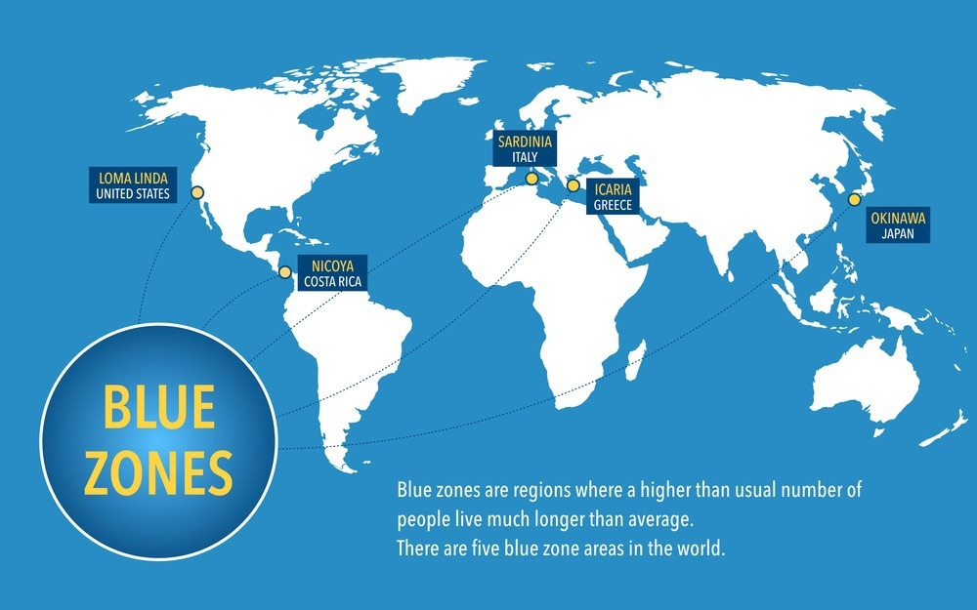

Slide 17
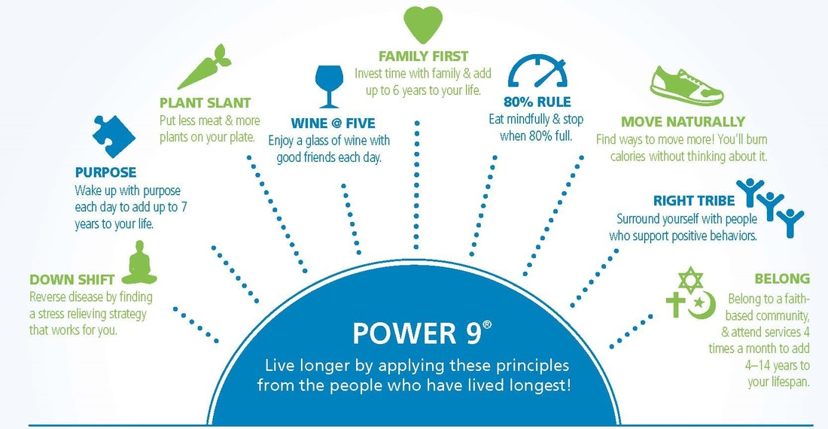

Slide 18
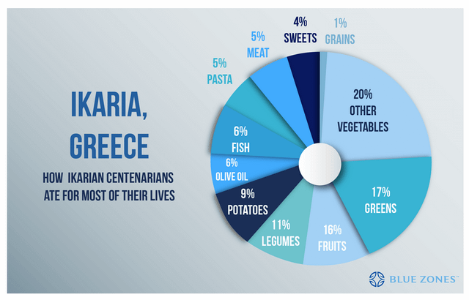

Slide 19


Slide 20
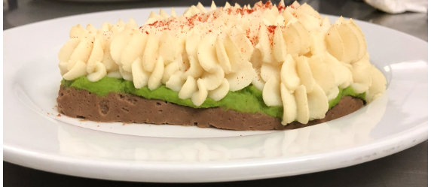

Slide 21
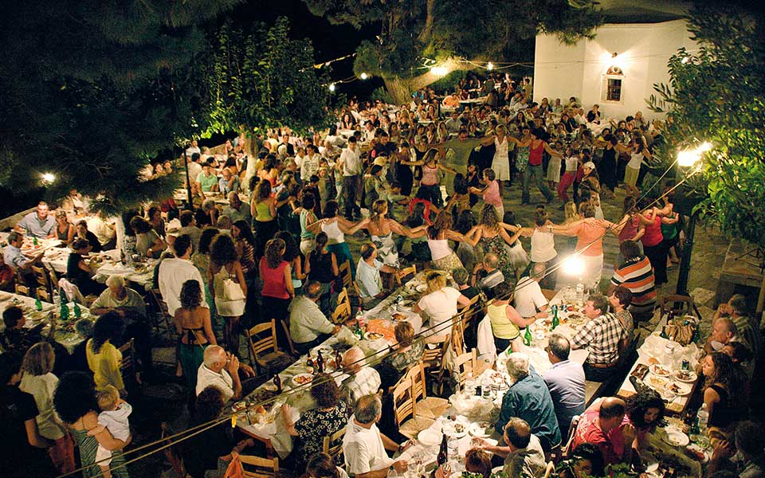

Contact
Toll-free: 1-877-952-3181
In Victoria: 250-952-3181
Monday to Friday: 8:30am–4:30pm
www.seniorsadvocatebc.ca
info@seniorsadvocatebc.ca
facebook.com/SeniorsAdvocateBC
@SrsAdvocateBC

