Slide 1

How to be an Attractive Employer
Costis Prouskas PhD
Psychologist – Dr of Gerontology
prouskas@aktios.gr

Slide 2

Long Term Care in Greece
No public sector nursing care units in Greece
Is based on a mixed system comprising and combining:
  Informal Care
  Formal Care
Legal responsibility for the financial and practical support of dependents is placed firmly on Family
The State support for non-self-sufficient older people includes:
  Limited direct provision via Social Services
  Coverage of some of the needs of care through social insurance
  Very limited support to informal caregiving through tax reductions when income is low
  Coverage of a daily rate for admission to Non for Profit Elderly Care Units
The State provides Long-Term-Care through:
  Chronic Diseases Clinics
  Psychiatric Hospitals
  Recovery Centres for Physical and Social Rehabilitation
The non-profit and for-profit private organizations operate residential homes (Elderly Care Units) and some care-at-home services for older people.

Slide 3
Elderly Care in Greece
Approximately 300 residential units exist in Greece each with an average of 45 beds of which half are for-profit (2020)
Total number of beds: 14500
Services provided are nursing/medical care and hospitality services
55% are licensed according to the 1980 law.
Price range: between €600 to €1200 for non-for profit and €800 to €2500 for profit + Vat 13%

Slide 4
Supply & Demand
 | % of Local Population | % of national Elder pop.
North Macedonia | 27% | 6%
Central Macedonia | 25% | 17%
West Macedonia | 27% | 3%
Epirus | 30% | 4%
Thessaly | 28% | 8%
Central Greece | 28% | 6%
Ionian Islands | 27% | 2%
Western Greece | 26% | 6%
Peloponnese | 29% | 6%
Attica | 23% | 32%
North Aegean | 29% | 2%
South Aegean | 22% | 2%
Creta | 23% | 5%
Region | No of LTC Units
North Aegean | 10
South Aegean | 10
Ionian islands | 9
Western Greece | 13
Thessalia | 7
Peloponeese | 12
Attica | 143
Crete | 24
Epirus | 6
Western Macedonia | 4
Eastern Macedonia & Thrace | 10
Central Macedonia | 29
Central Greece | 18
Total | 295

Slide 5

Workforce Concerns

Slide 6


Concerns
High turnover rates
Lack of standardized training and clear professional profiles
Training is instead often reliant on individual care provider efforts
Inequalities in pay & conditions (across public and private service providers)

Slide 7

Model of care: A Bicycle
What does a bicycle need to stay in motion?
Route/
Course of Treatment
Dementia Patient
Management
Daily routine and protocols
Medical Care
Assessment
Nursing Care

Slide 8

Psychosocial Sector and Dynamic Model: The Centrifugal and Centripetal Powers
Linear/ Static intervention
Change of route
Flexibility
Acceptance of difference
Alternative routes
No predetermined destination
Dynamic intervention
Straight route
One Direction
Predetermined destination

Slide 9
Dynamic Model
Facilities, Equipment, Decoration and Hospitality
Residents: Evaluation, Individualized Services, Quality Assurance of Care and Quality of Life
Family: Understanding, Support, Information and Cooperation
Community: Information, Raising Awareness, Education, Training of New Scientists, Intergenerationality
Daily Schedule, Activities, Interventions, Operating Protocols
Employees: Training, Concern, Development, Support
Building
Residents
Family
Daily Schedule
Community
Employees

Slide 10
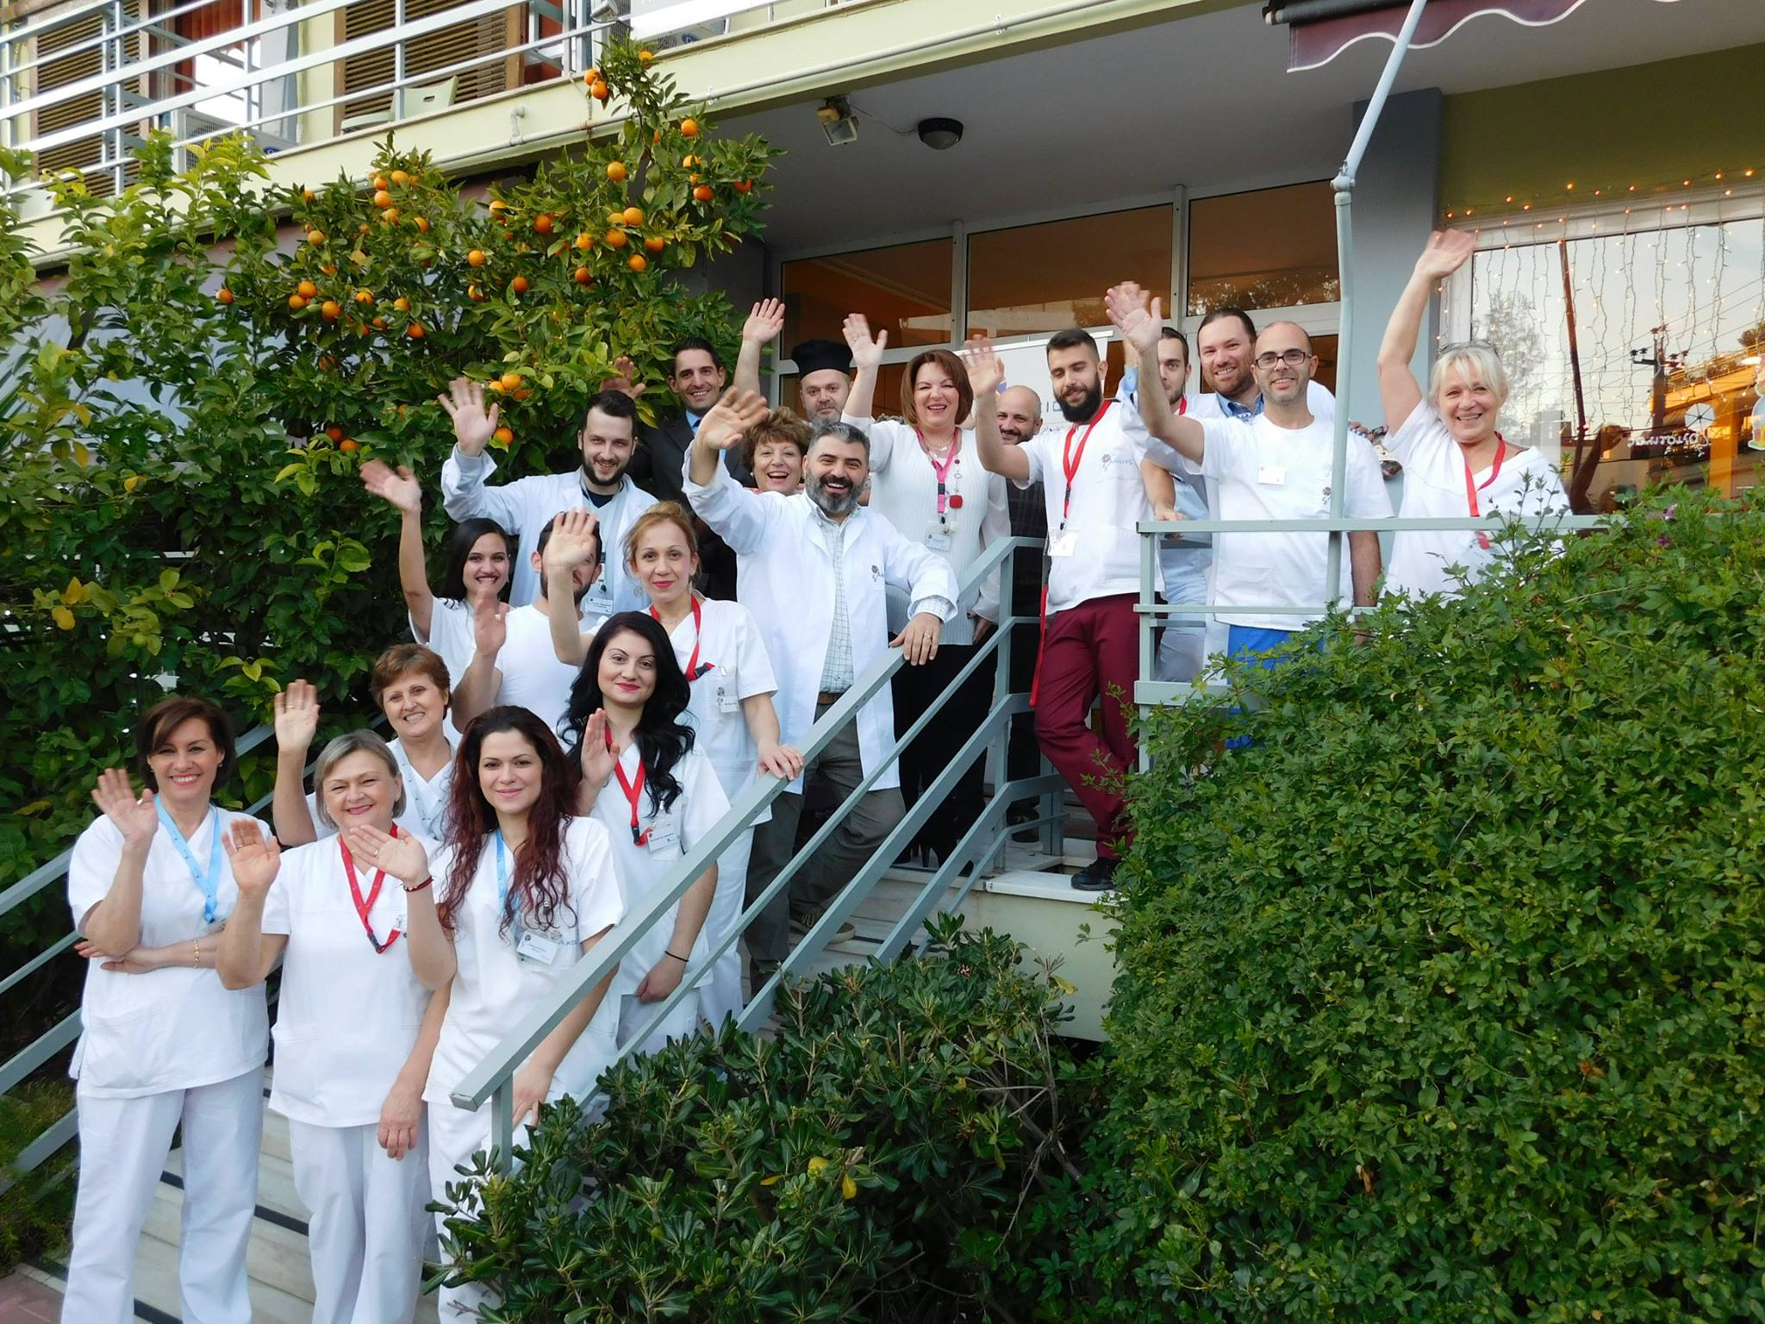
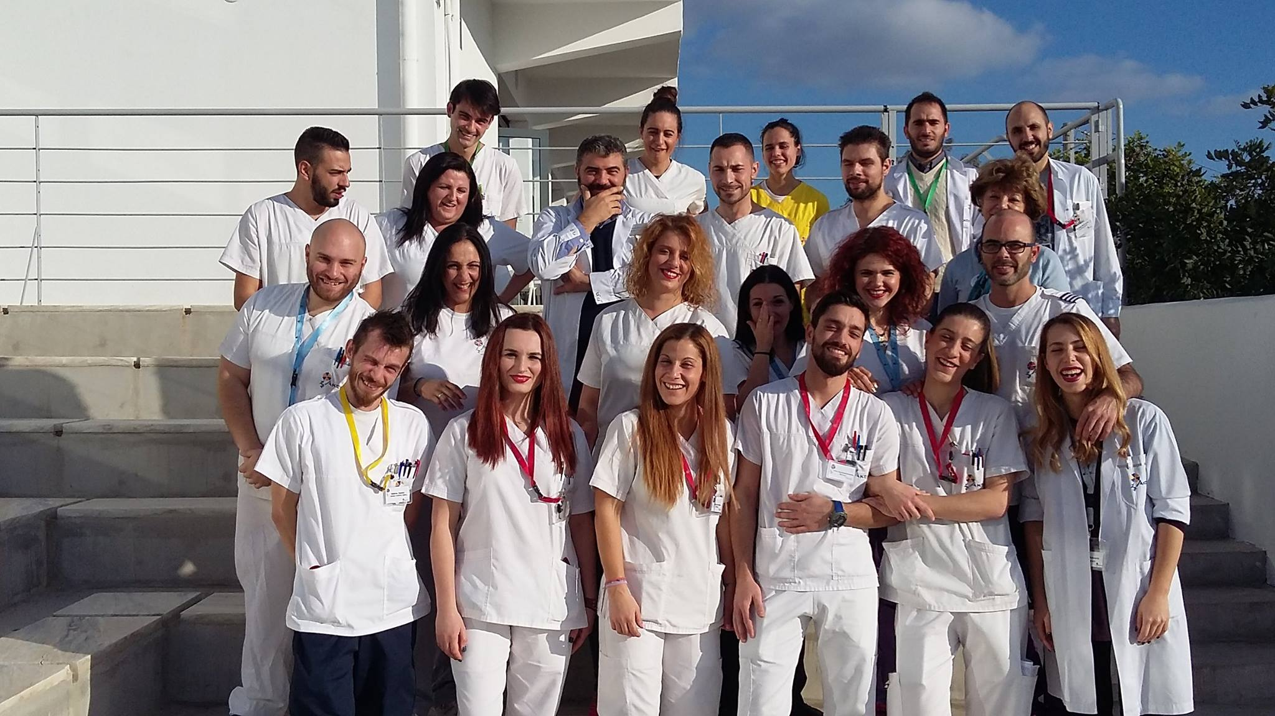
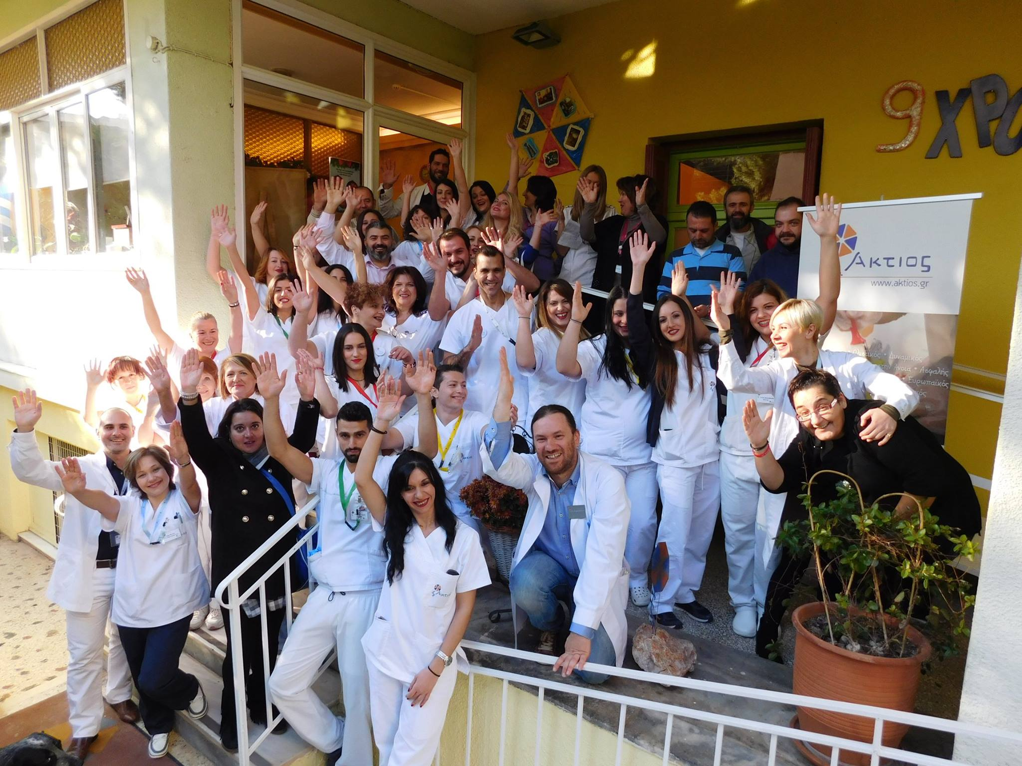

6. Employees: Training, caring, development, support

Slide 11
Employees: Key contributors in the processes, changes and operation of Aktios
Caring to build cooperation in multidisciplinary team
Creating an effective team
Integration and «Aktios-ization»
Common Goals
Constant Training
Organization of work
Management of change
Empowerment
Discharge

Slide 12
Effective Team
Clear Goals
Incentives for members
Open-ended communication with plenty of feedback
Good leadership
Clear role distribution
Including everyone
Minimal absences
Satisfaction of all parties involved
High productivity

Slide 13



Slide 14


Slide 15
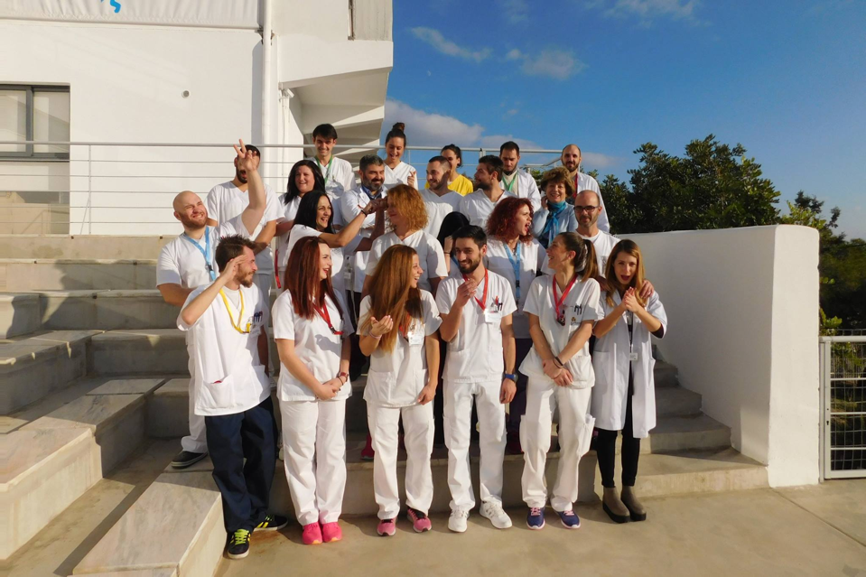

Slide 16
Employees: Empowerment
  Employees’ Groups
  Quality supervision
  Discussing work-related issues
  Ensuring individual labor rights
  Provision of private insurance contract
  Separation of personal and professional life
  Understanding and support in family-related difficulties

Slide 17
Employees: Discharge
  Communication between shifts
  Supervision and support: (Head nurses, nurse supervisors, mentors)
  Staff meetings
  Communication incentives
  Parties and unit activities
  Team building
  Playing

Slide 18
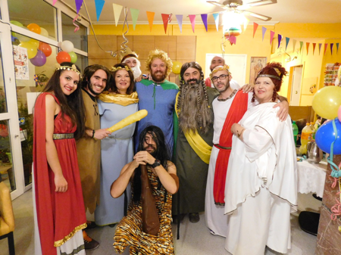
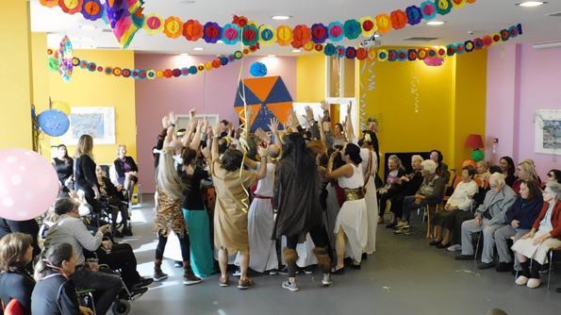

Slide 19
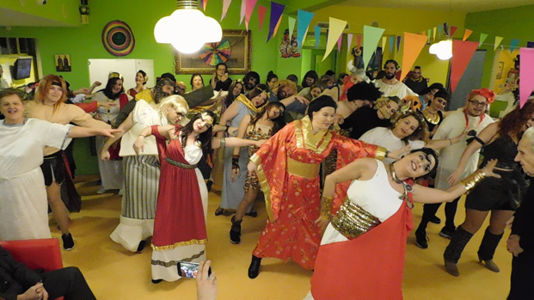
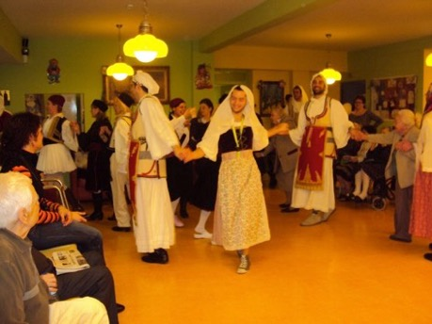

Slide 20
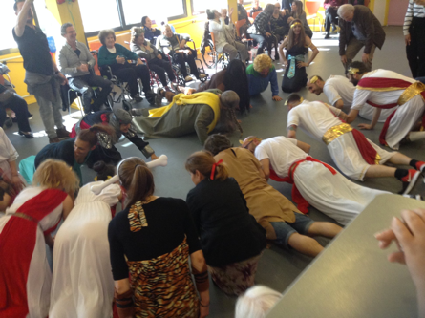
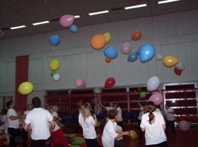
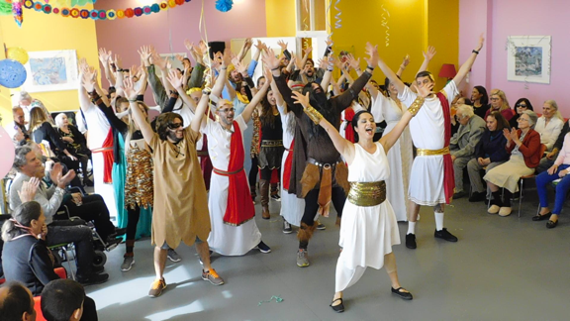

Slide 21
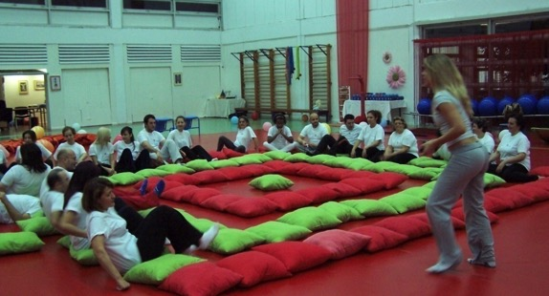
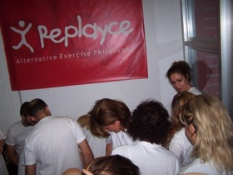
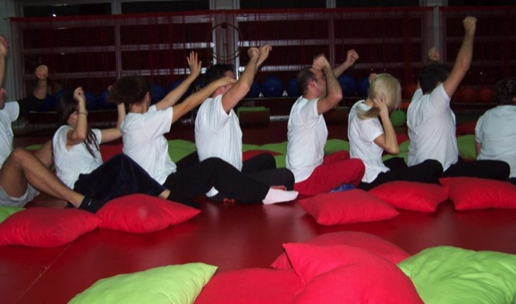

Slide 22
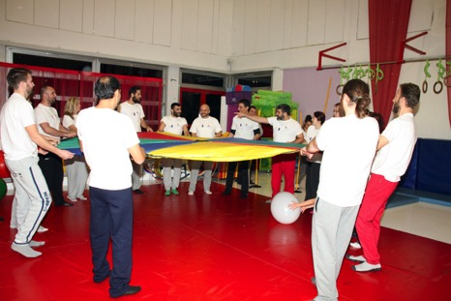
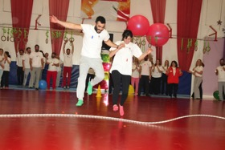
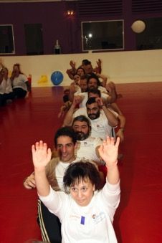
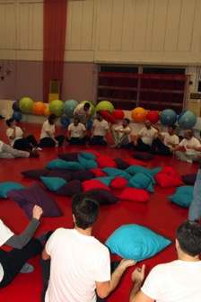
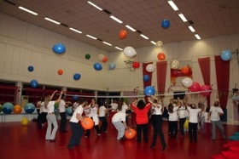

Slide 23
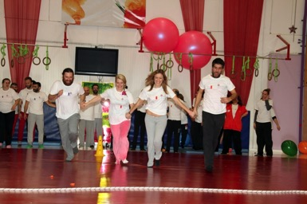
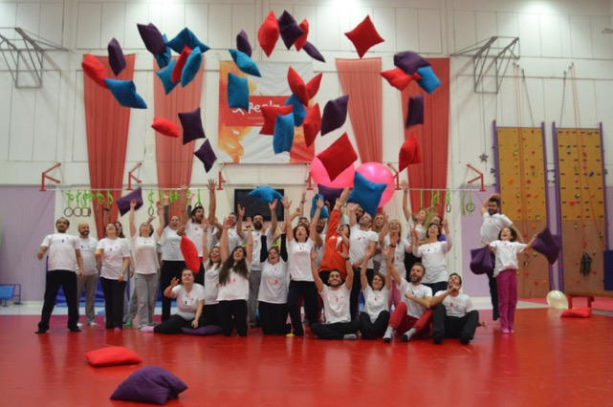
Employees: Caring
Are all of these necessary?
YES
Satisfied and protected employees can provide the most essential ingredient for quality assurance:
Their own self

Slide 24
HERO Training Programme Erasmus+

Slide 25
HERO Project (Erasmus+)
Training programme for refugees & migrants in Elderly Care and prevention of infectious diseases
Aiming at the seamless integration of refugees from African & Middle Eastern countries into the Western world
Duration: September 2020 – December 2022

Slide 26
HERO Project (Erasmus+)
Partners:
  MATERIA Group (Cyprus)
  AKTIOS (Greece)
  Cyprus University of Technology (CUT; Cyprus)
  National Institute for the Care of the Elderly - INRCA (Italy)
  Computer Solutions S.A. (Greece)
  DomusVida (Portugal)

Slide 27
Objectives
Inclusive solution for the social integration of migrants and refugees in European countries, especially in the Mediterranean countries
Creation of an educational technological tool (platform and application) for training in elderly care and local language & culture

Slide 28
Objectives
Certification after training and recruitment in the care sector
The ultimate goal is the smooth integration of refugees into the local labour market and the improvement of their quality of life

Slide 29
Results
82 participants in total
  24 in Greece
  20 in Cyprus
  11 in Italy
  27 in Portugal
17 drop-outs
    Answered the pre-training questionnaire and left
21 participants completed the training in Greece and were offered a job position

Slide 30
A fight for the self-evident
Cooperation between all parties involved
Respect to the residents’ needs and their families’ needs
Development of intergenerational activities
Stay in touch with the Community
Provide a diverse environment
Care for the employees
Goal: Providing quality care for elderly people with dementia, ensuring quality of life, empowering older people and their carers

Slide 31
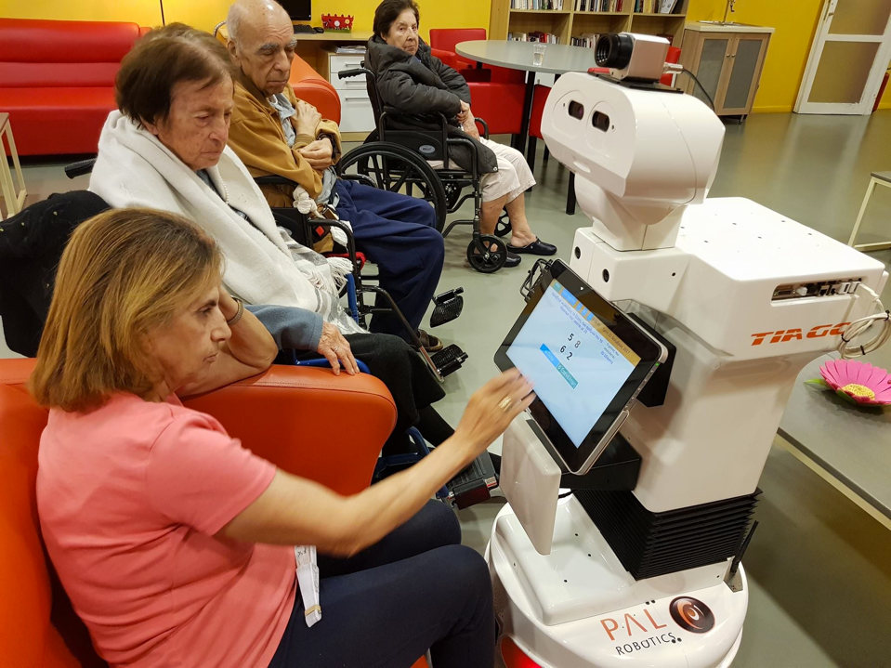
Aktios’ Dynamic Model of Care:
A combination of acceptance, diversity, color, music, playing, communication, innovation, personal and professional development, awards, expertise, quality of care, knowledge transfer, training and education, understanding and respect for everyone involved.
A system of care based on each of us, with our limitations and our full potential

Slide 32
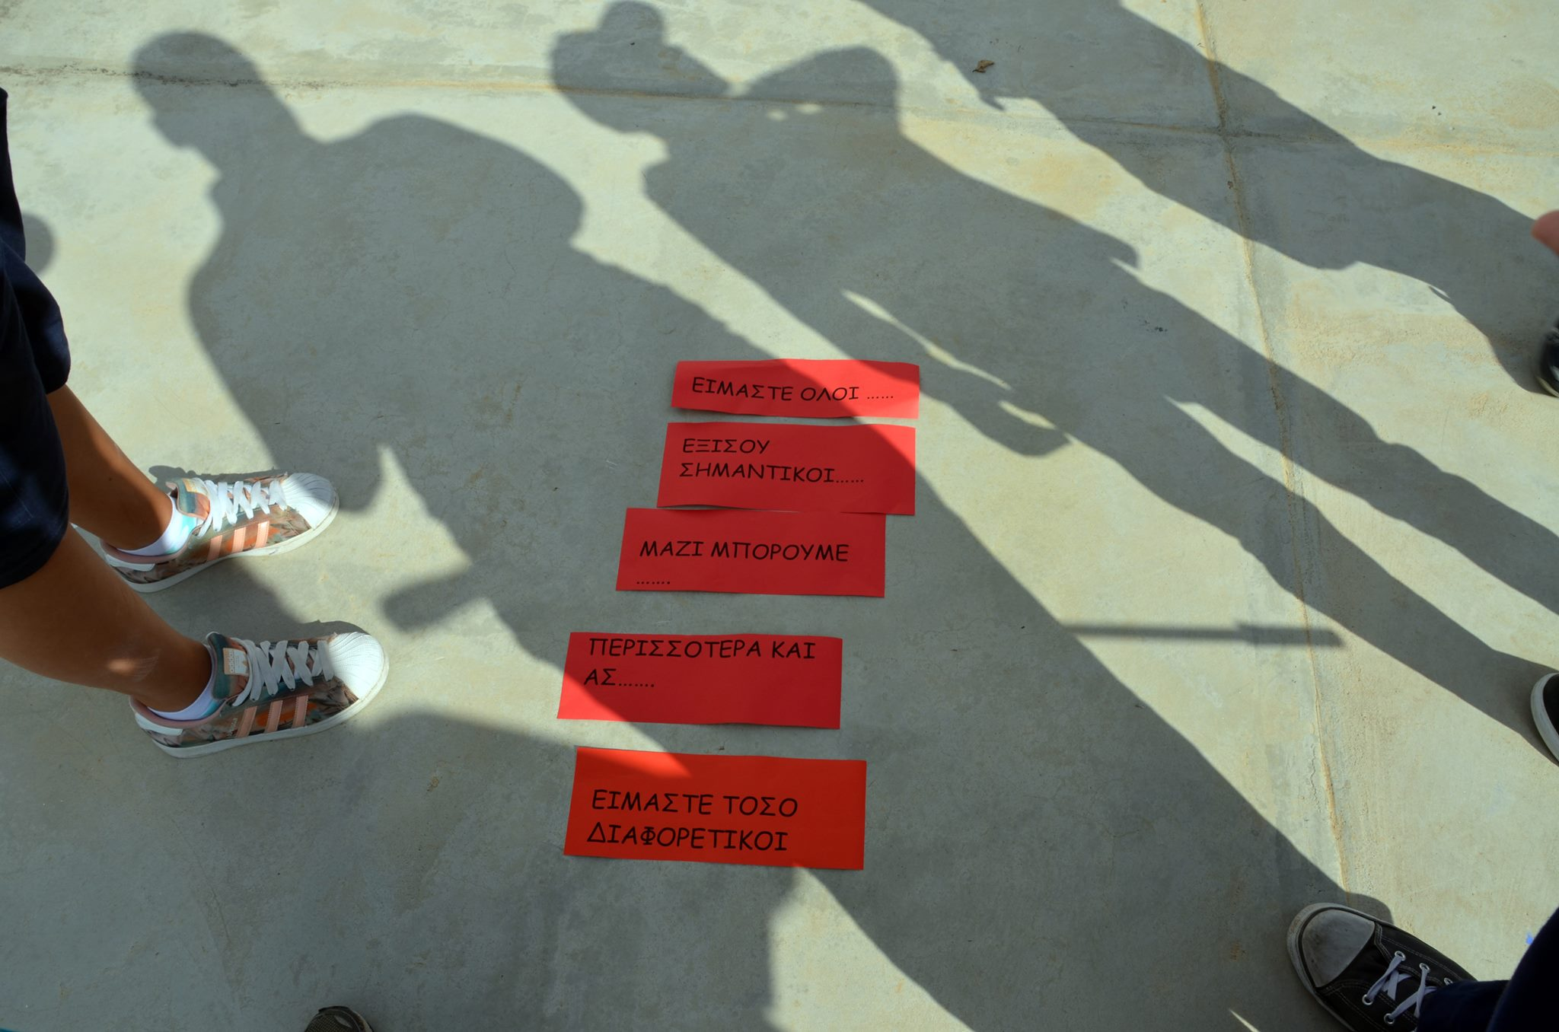

Slide 33
We are all equally important
Together we can accomplish more, even though we are so diverse!

Slide 34
How to be an Attractive Employer
Costis Prouskas PhD
Psychologist – Dr of Gerontology
prouskas@aktios.gr

